Slide 1
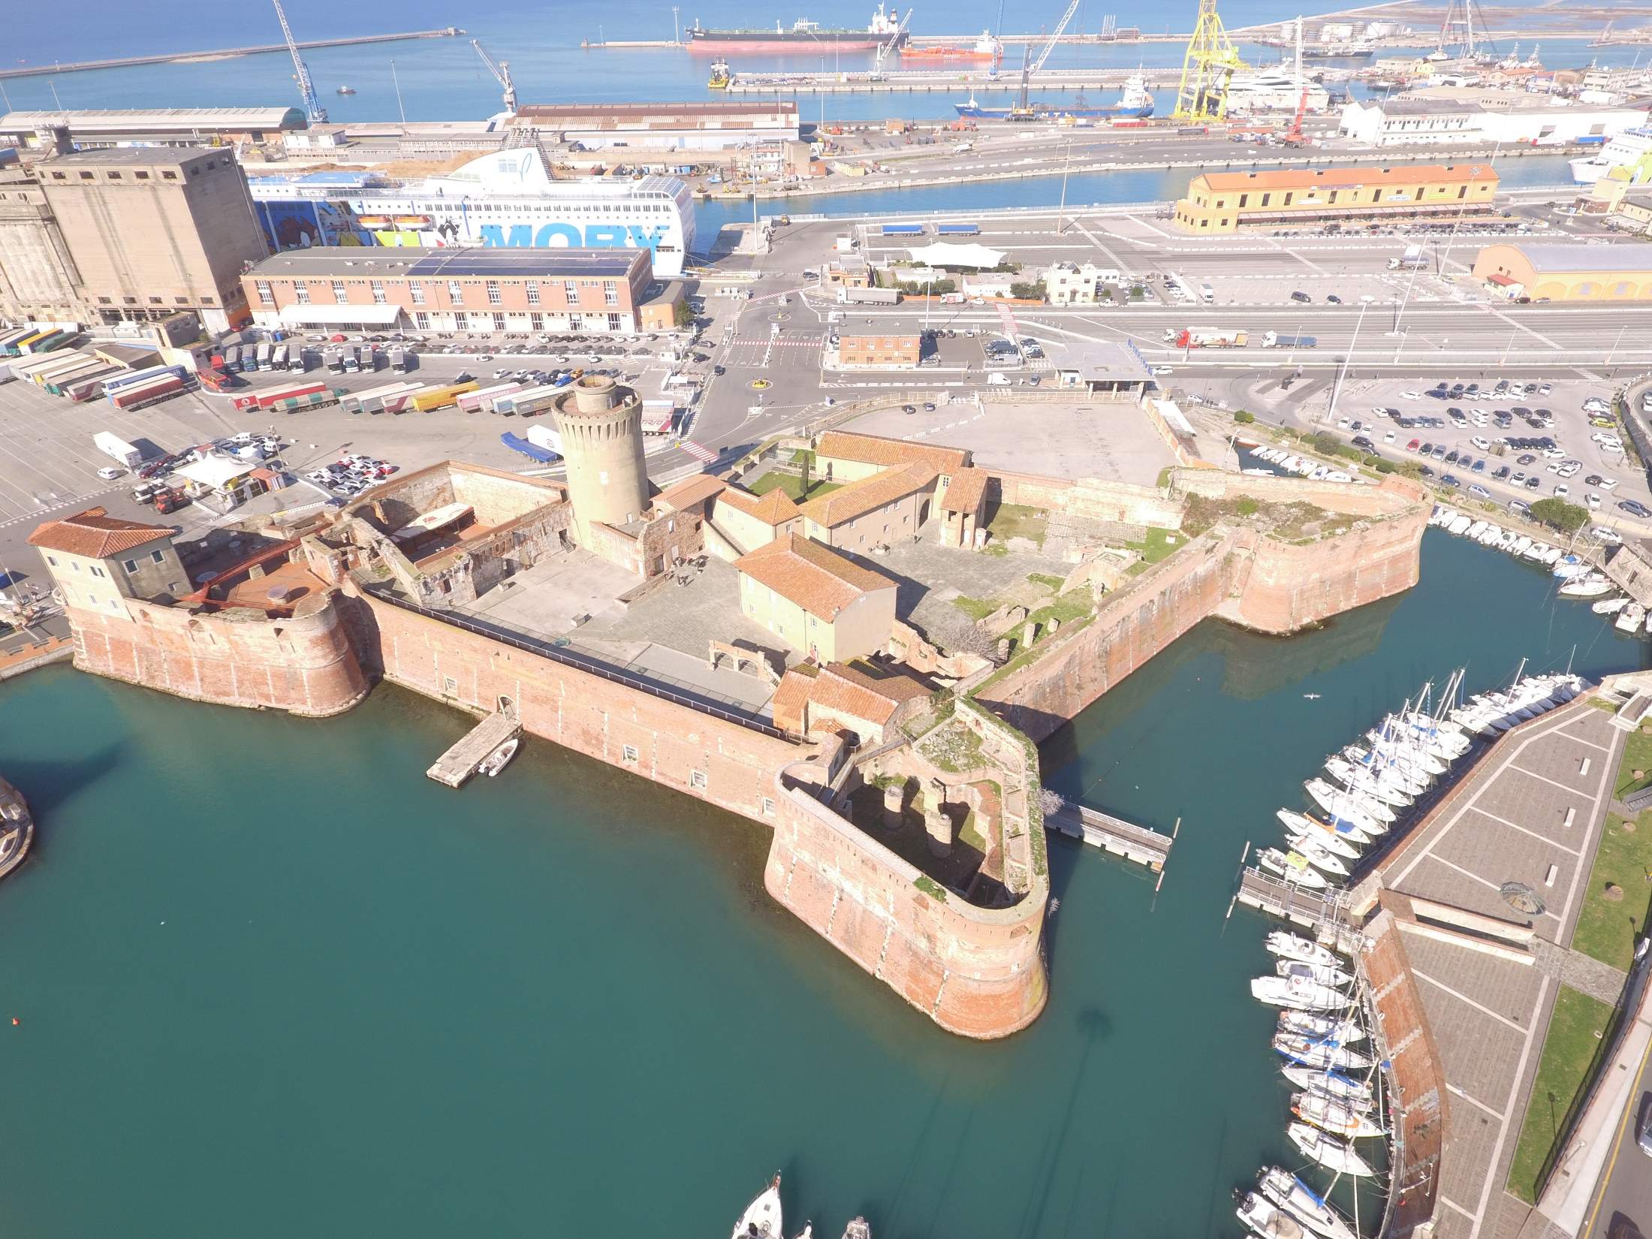
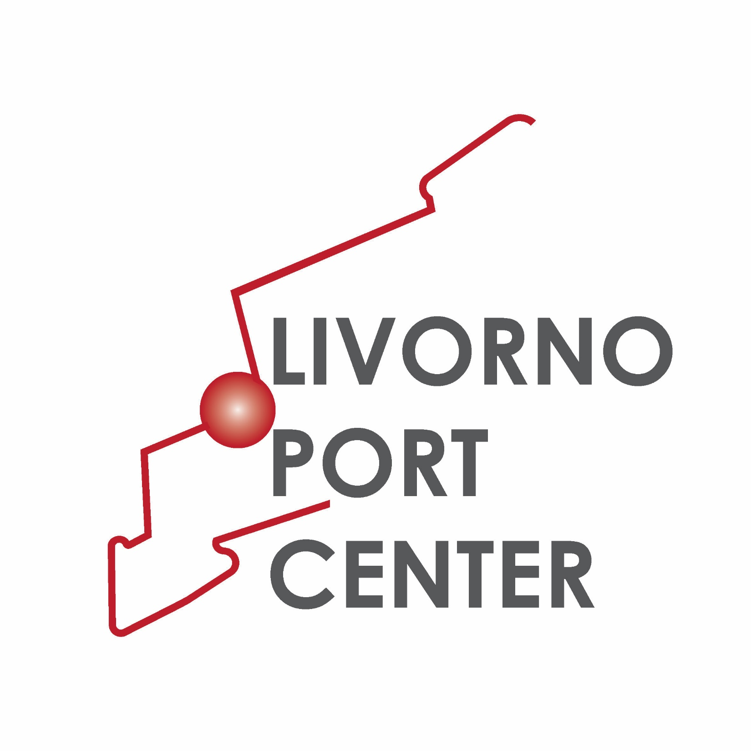
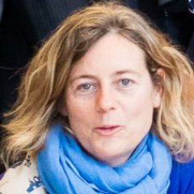
Livorno Port Center
Name: Francesca Morucci
Position: Head of Public Relations Office
Contact: f.morucci@portialtotirreno.it
The Livorno Port Center has been created in 2015 on the wake of “Porto Aperto” project and of Port Authority’s open port activities in order to improve the social and cultural relations between the city, the territory and the port.

Slide 2
Key Data of Livorno Port Center
Port Center (building): Fortezza Vecchia (Livorno Old Fortress)
Year of creation: 2015
Actors involved: Port Network Authority of the North Tyrrhenian Sea (formerly Livorno Port Authority)
Website: www.livornoportcenter.it www.portialtotirreno.it
Audience: children, students, general public
Key themes: discovering and experiencing the port from the inside; technology to allow different kinds of interaction; promotion and dissemination of the port values by using tools that can generate aware and pleasant experiences
 | 2016 | 2017 | 2018 | 2019
Nº of visitors | 1,000 ca | 2,300 ca | 2,500 ca | 1,300 ca up to now + 500 ca expected within 2019
Budget | No specific budget (a general budget of € 250,000 per year devoted to Old Fortress/Port Center/Historical Vessels Showroom) | No specific budget (a general budget of € 250,000 per year devoted to Old Fortress/Port Center/Historical Vessels Showroom) | No specific budget (a general budget of € 250,000 per year devoted to Old Fortress/Port Center/Historical Vessels Showroom) | No specific budget (a general budget of € 250,000 per year devoted to Old Fortress/Port Center/Historical Vessels Showroom)
Key activities | School visits to the multimedia lab; tour of the port of Livorno; visit to the Historical Vessels Showroom | School visits to the multimedia lab; tour of the port of Livorno; visit to the Historical Vessels Showroom | School visits to the multimedia lab; tour of the ports of Livorno, Piombino, Portoferraio; visit to the Historical Vessels Showroom | School visits to the multimedia lab; tour of the ports of Livorno, Piombino, Portoferraio, Capraia; visit to the Historical Vessels Showroom
Projects of the year | PORTO APERTO IX Edition Saturday opening of Port Center | PORTO APERTO X Edition – 10th Anniversary special celebrations: “Conurgenza Project”; Historical Vessels Showroom restoration | PORTO APERTO XI Edition “I giovedì del Port Center” (Thursadays at the Port Center) 1st season on the wake of “Le jeudis du LH Port Center”. | PORTO APERTO XII Edition “I giovedì del Port Center” (Thursadays at the Port Center) 2nd season “Navi di Maggio” (School visits to vessels equipped for enviromental activites) – May 2019

Slide 3
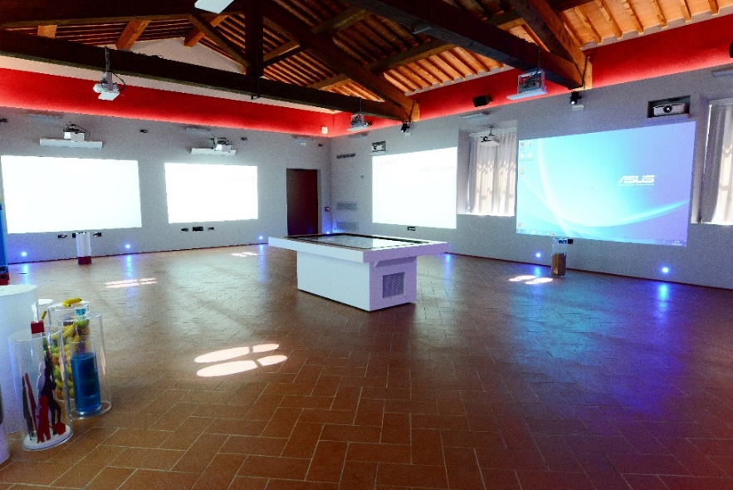
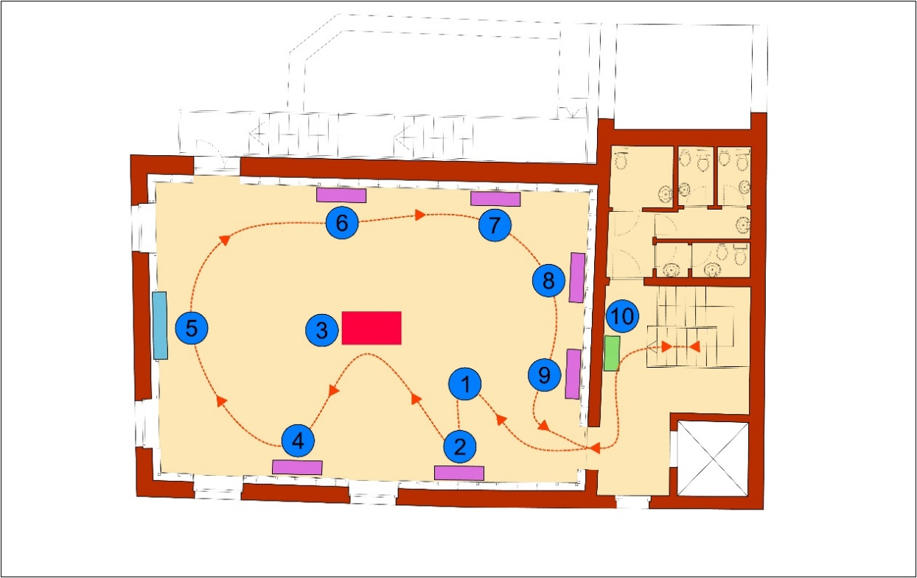
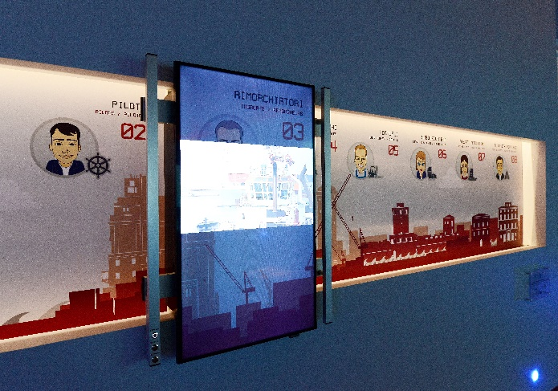
Please give us a couple of examples of the main projects you have developed in your port center and how you evaluate its success
Project title and year | Brief description | How successful?
Dibattito in Porto (Public Debate) 2016 | Process of information, discussion and debate about two works and projects of infrastructural requalification of the port of Livorno involving environmental, local, conservation, social, cultural and economic issues (mandatory by Tuscan Regional Law Nr 46/2013 in relation to any public or private works involving total investment of over EUR 50 million) | The Port Center was chosen as headquarters of all the debate activities. Furthermore, the Multimedia room holding a touchscreen table allowing to explore the port, a specific section with contents about the public debate accessible through virtual interactive maps has been implemented
PORTO APERTO project | Guided tours to the ports belonging to the Port Network; “Porto Aperto News” local television broadcast; Livorno Port Center and Historical Vessels Warehouse as an integral part of the general project | Starting from its first edition in 2007, the project has involved more than 19.000 students (an average of 100 students every week during the school year)
What have been the main difficulties to develop your Port Center or the associated activities?
Example 1: The source of revenues. The Port Center and all its activities have been almost totally financed by the Port Network Authority
Example 2: Drawing general public. The best feedback is from the schools, while private people is less responsive to the Port Center activities

Slide 4
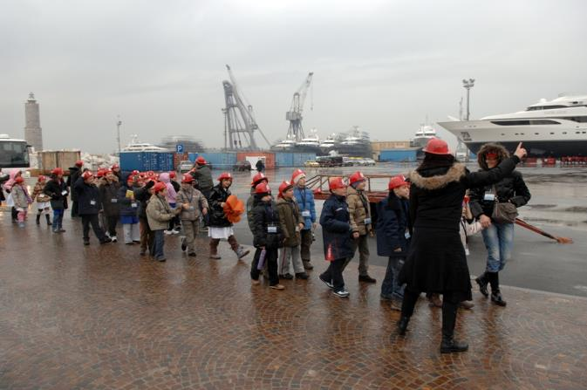
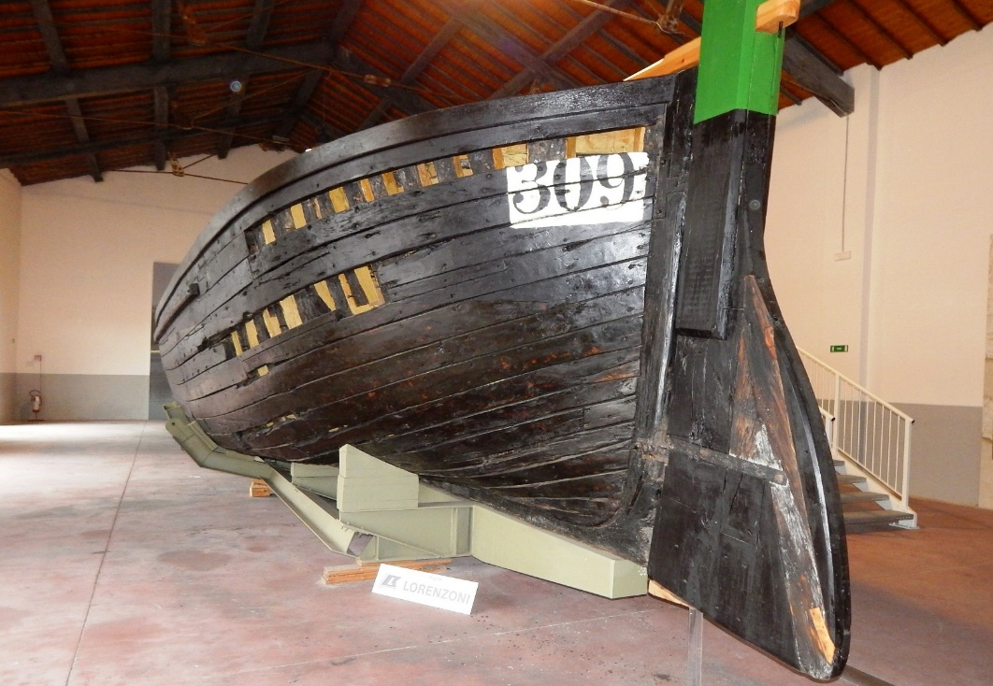
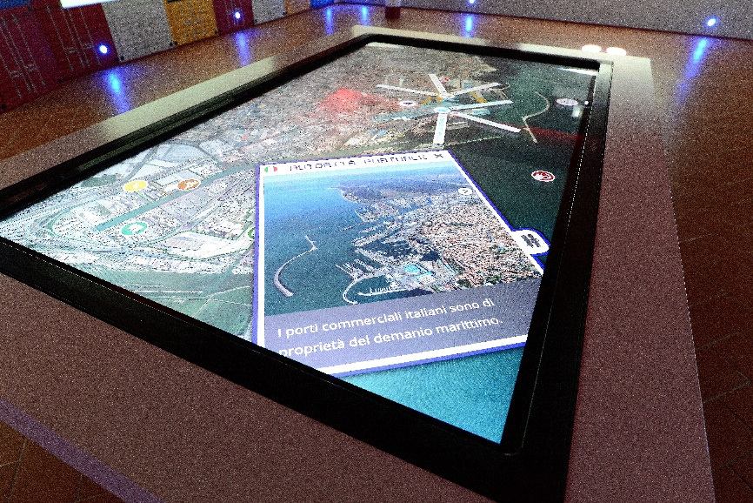
What are your goals/expectations for the PCN Meeting in Bilbao ?
Sharing good practices and experiences
Finding new strategies to face the main difficulties associated with the Port Centers’ activities
Fostering and strengthening the Port Center Network by joint activities
What useful knowledge should AIVP provide you with?
Other Port Centers’ projects
How other European Countries manage the port-city interface issues
How other Port Centers manage their project and activities
Key topics for future PCN Meetings
Port Centers: discovering the new networking/members
How to relaunch the Port Center activity for general public

