Slide 1
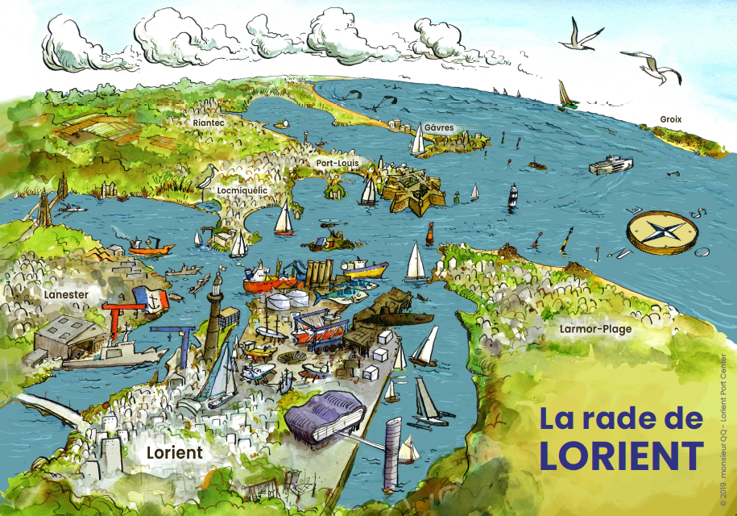
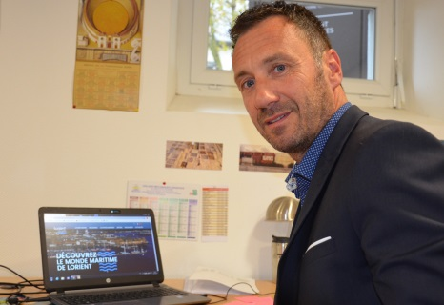
Lorient Port Center
Name: Antich Y amengual Frank
Position:
Contact: f.antich@audelor.com
Port centers allow us to create a new relationship with ports and to strengthen ties with the inhabitants of the port town that may have weakened.
Since 2016, the specificity and the force of the Port Center concept in relation with Lorient Agglomeration is that it covers all the sites and maritime sectors

Slide 2
Key Data of your Port Center
Your Port Center (building or platform): Platform
Year of creation: 2016
Actors involved (or approached): AudéLor, Lorient Agglomération, University, House of the sea, BPN, LGL…
Website (insert the link if you have): https://www.lorientportcenter.com/
Audience (children? general public? Students ? All of them?): 500 /month
Key themes for your Port Center: Shipbuilding and ship repair, the fishing sector, shellfish farming, the commercial port, boading, french navy, renewable marine energy
 | 2016 | 2017 | 2018 | 2019
Nº of visitors (or expected)
Budget |  |  | 30 000 euros | 30 000 euros
Key activities |  |  | Website, communication, happening, | communication tools, happening, professional gathering
Projects of the year |  |  | New Website : Lorient Port Center | Professionnal gathering, happening,

Slide 3
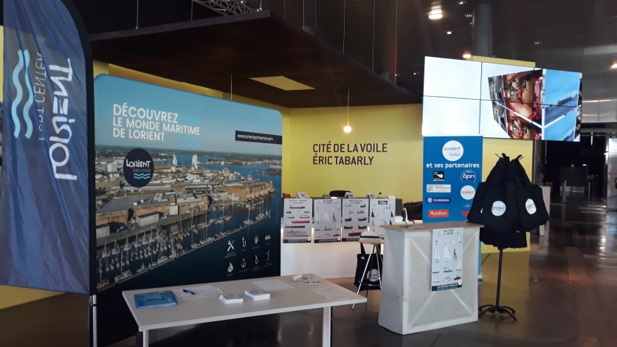
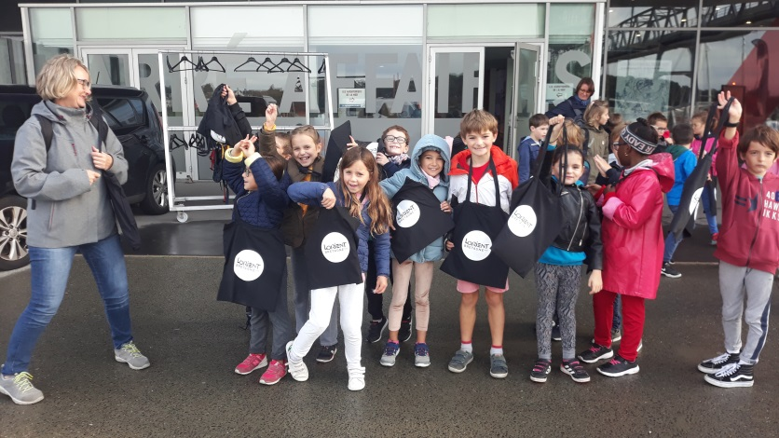
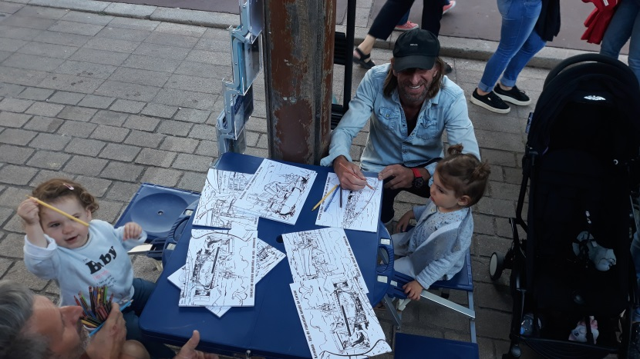
Please give us a couple of examples of the main projects you have developed in your port center and how you evaluate its success
Project title and year | Brief description | How successful?
communicate with young public | Create educational and fun communication materials on the different ports of Lorient. | Very Good
inform and aggregate sea professionals | (creation of) Create professional meetings to valorize the differents ports and also to make them meet. | Very Good
provide information on maritime professions | creation of communication tools | Good
Replace for photos of your Port Center
Replace for photos of your Port Center
What have been the main difficulties to develop your Port Center or the associated activities?
Example 1 : co-construction of the global approach
Example 2 : Exist on the territory by being dematerialized
Example 3:

Slide 4
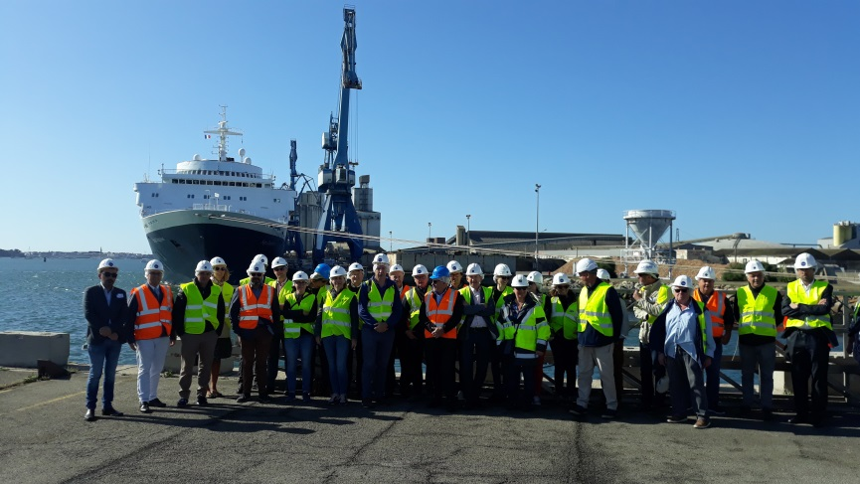
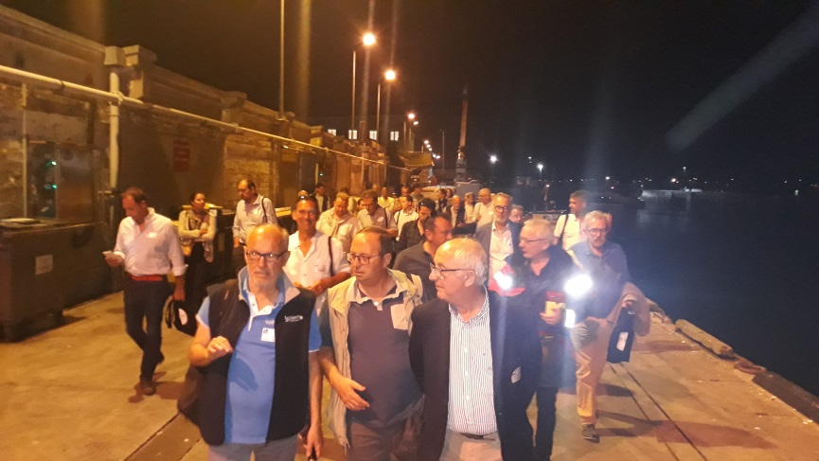
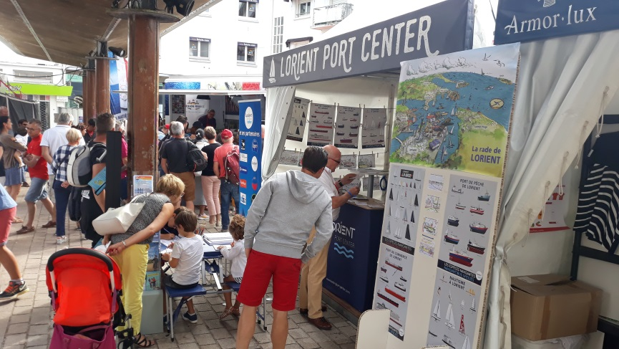
What are your goals/expectations for the PCN Meeting in Bilbao ?
exchange of experience
exchange on the models of Port Center
Culture and Port Center
What useful knowledge should AIVP provide you with?
Connecting with others port center
Discover other Port Center
…
Key topics for future PCN Meetings
…
…

