Slide 1
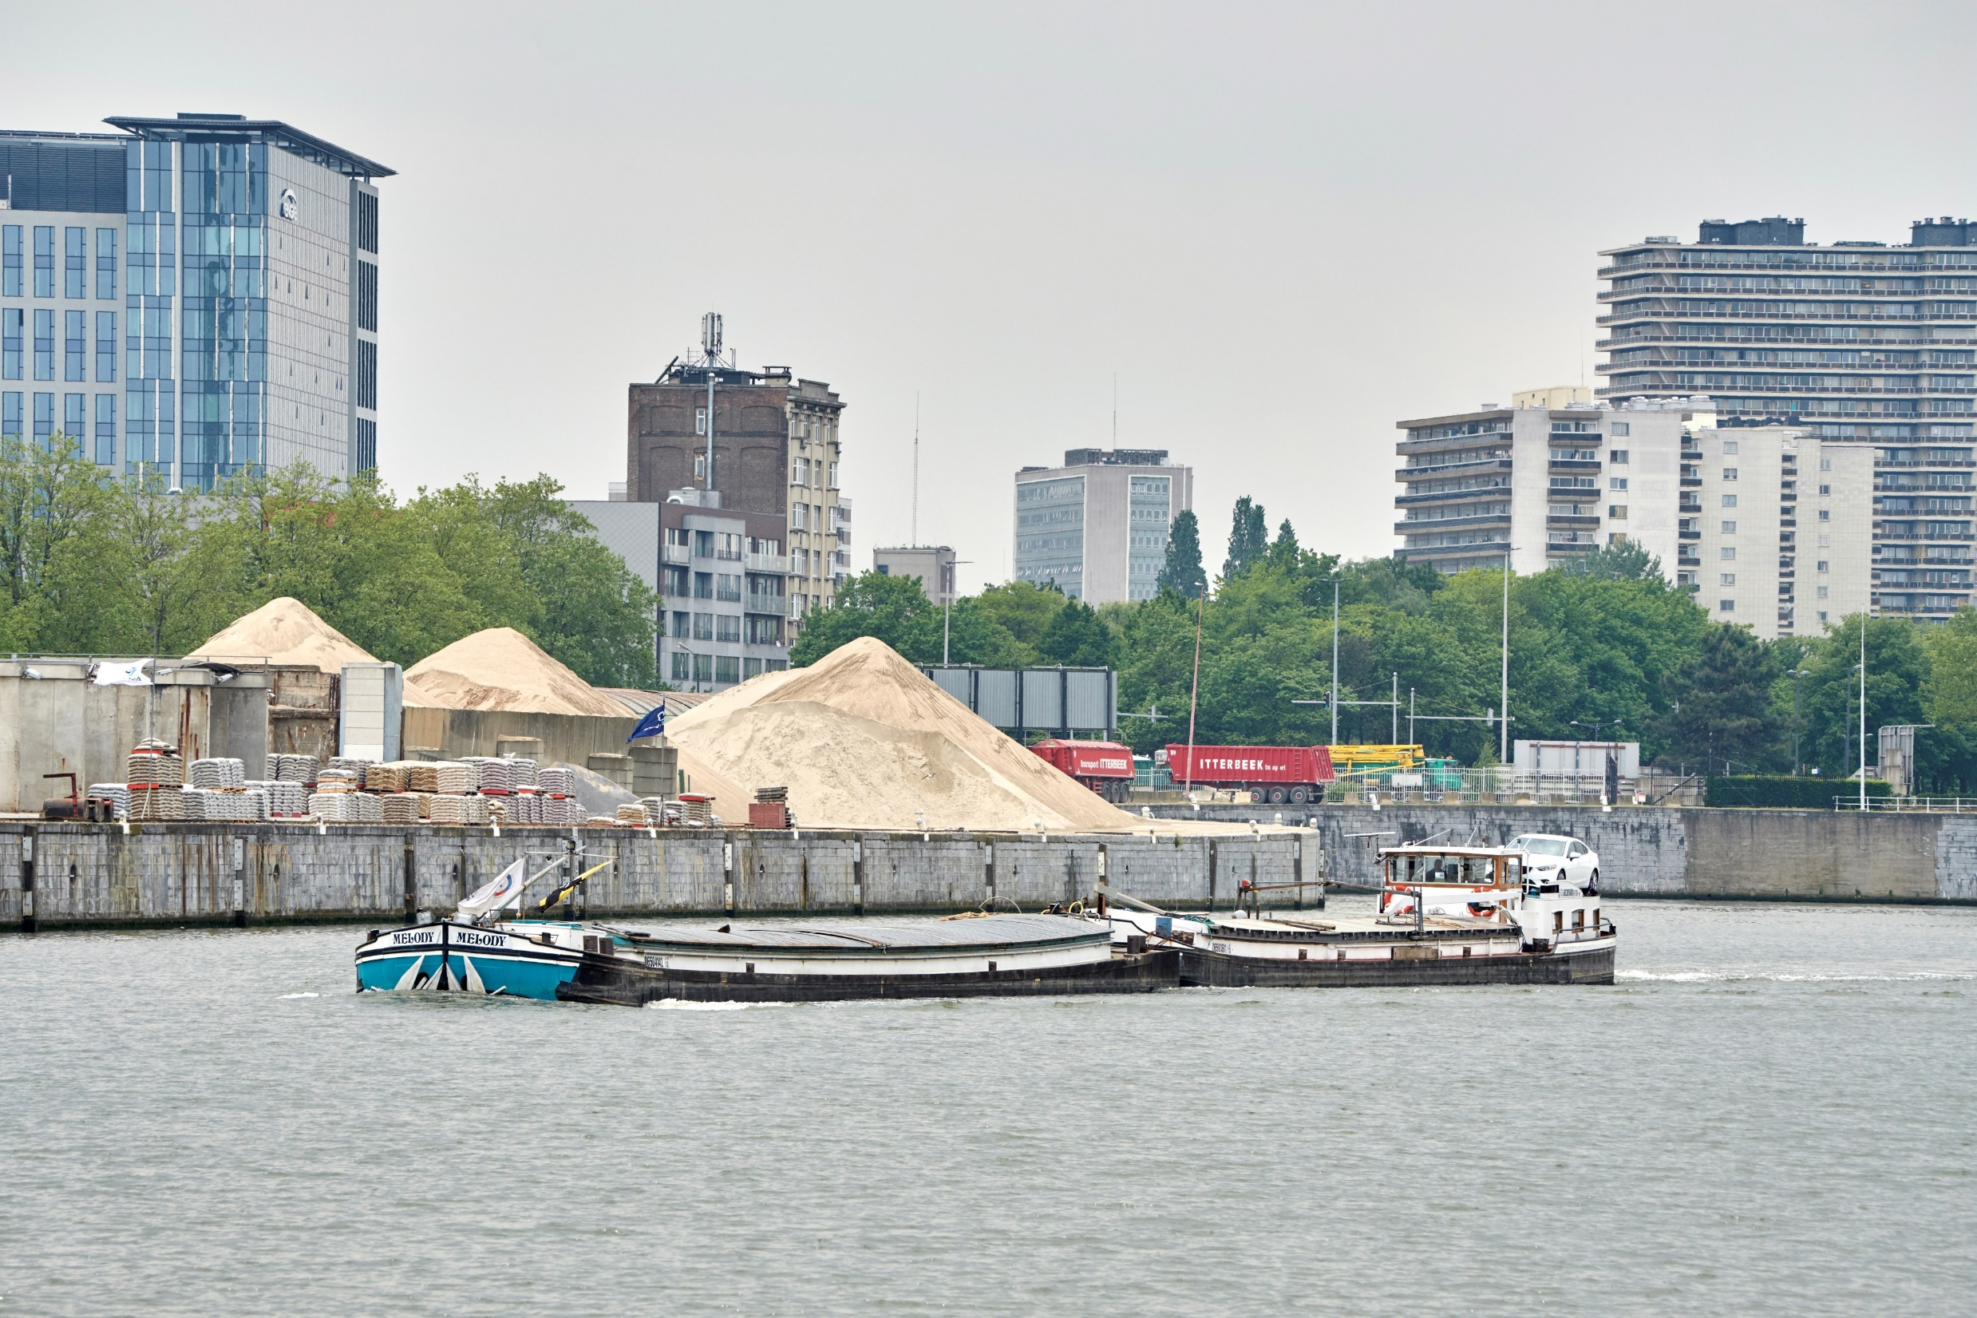
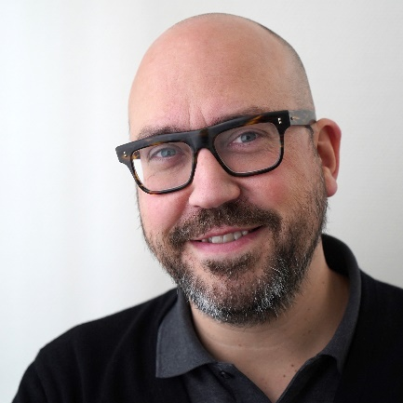
Port of Brussels
Name: Sylvain Godfroid
Position: Communication manager
Contact: sgodfroid@port.brussels
The Port of Brussels signed the AIVP Port Center Charter in June 2017. A location has been chosen and work has begun. We also aim to develop an extensive visit programme aimed at Brussels’ school children.

Slide 2
Key Data of your citizen initiatives
Which actors do you usually collaborate with? Inside resources (e.g. colleagues for visits), other public actors, associations
Website with information about social activities (insert the link if you have): www.feteduport.be
Key Audience for your initiatives (children? general public? both?): both
Social Initiatives you have recently developed | Year | Nº of visitors | Budget | Description
Brussels Port Festival | 2018 | 35 000 | 250 000€ | Biennial event taking place on the port estate with the aim of welcoming the general public in the port and allowing them, in a fun environement, to take conscience of different aspects of port activity.
Visit programme | In development | / | / | The aim is to work with Brussels’ primary schools (last two years) to include, on their yearly programmes, a visit to the Port of Brussels. The Port Centre (in development) would be an integral part of this visit, which would include a guided boat tour.
Brussels Port Centre | In developmentAim: 2021 | / | / | The location has been determined (Brussels Cruise Terminal), the preliminary works on site have begun and consultants are working on the scenography/museography. The aim is to open the Port Centre in 2021.
Events | Ongoing | / | / | The Port of Brussels takes part in several events organises in Brussels (water days, Brussels region day, etc.) The aim of the Port of Brussels is also to encourage the organisation of events in the port area that allow it, mainly reconverted public quays.

Slide 3
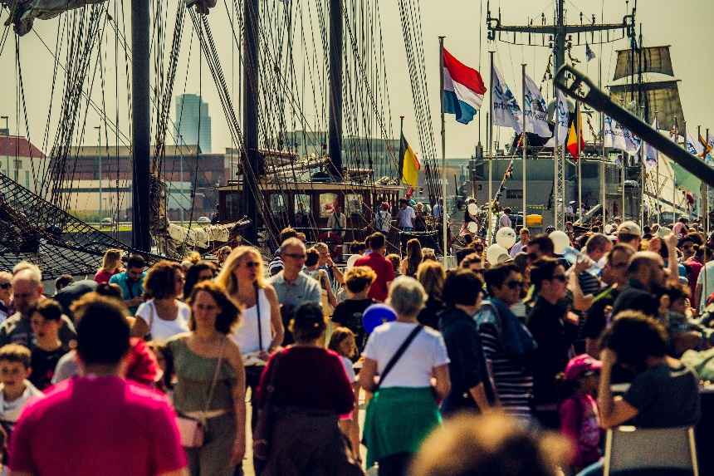
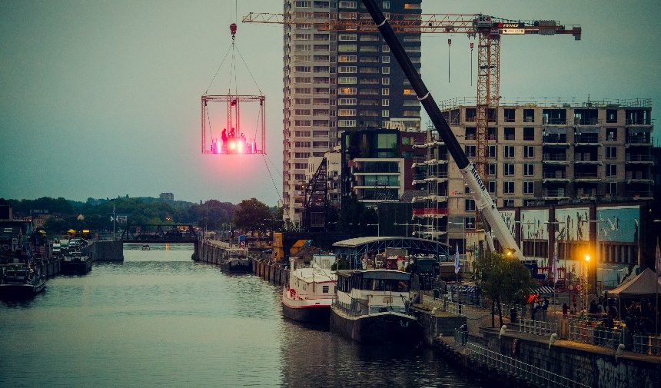
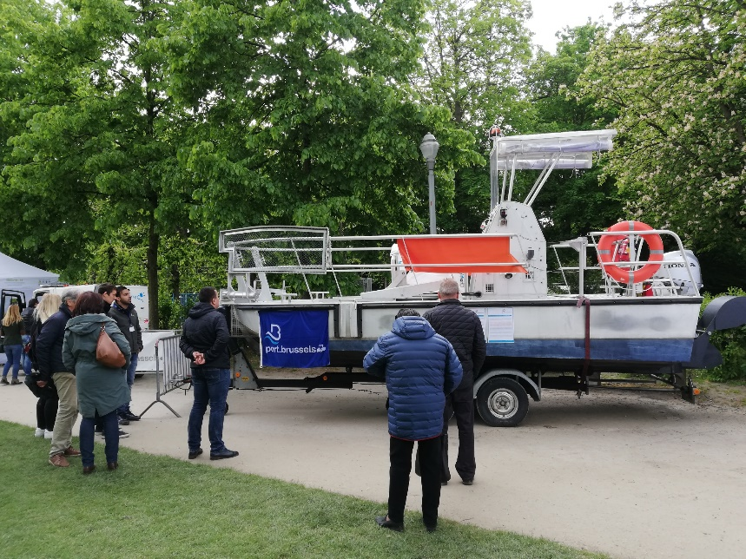
What have been the main difficulties to develop a citizen activities in your port city?
Lack of resources
Too many initiatives within the city
Lack of involvement from institutional partners
Key themes you would include in your future Port Center
Importance of the Port and its functions for the city
Include the Port Centre in a wider visit programme of the Port
Interactive and immersive activities

Slide 4
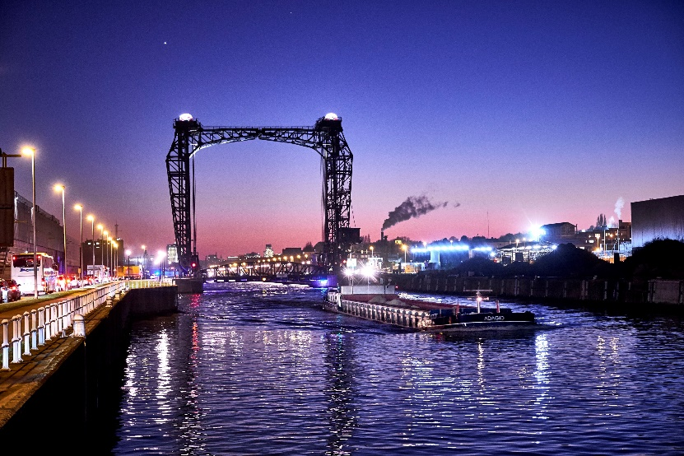
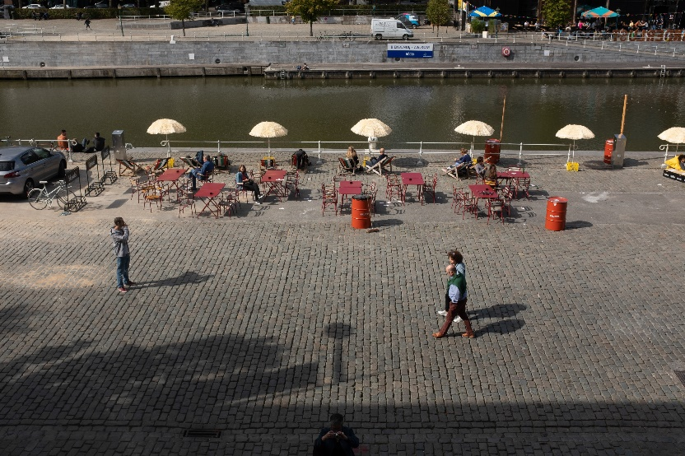
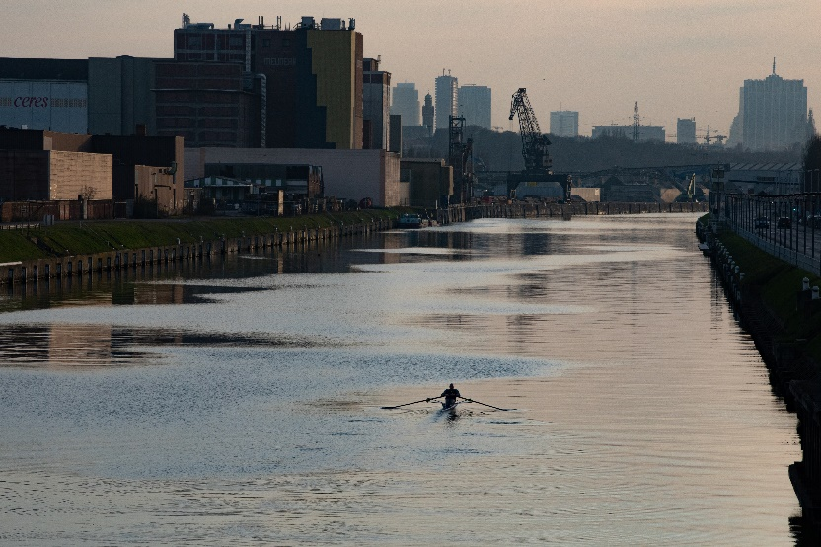
What are your goals/expectations for the PCN Meeting in Bilbao ?
Meet others involved in the creation and/or management of a Port Centre
Learn about the issues and challenges
Information about good practices
What useful knowledge should AIVP provide you with?
Good practices
Key common issues
Key topics for future PCN Meetings
As it is my first PCN meeting, no idea at the moment ;-)

