Slide 1
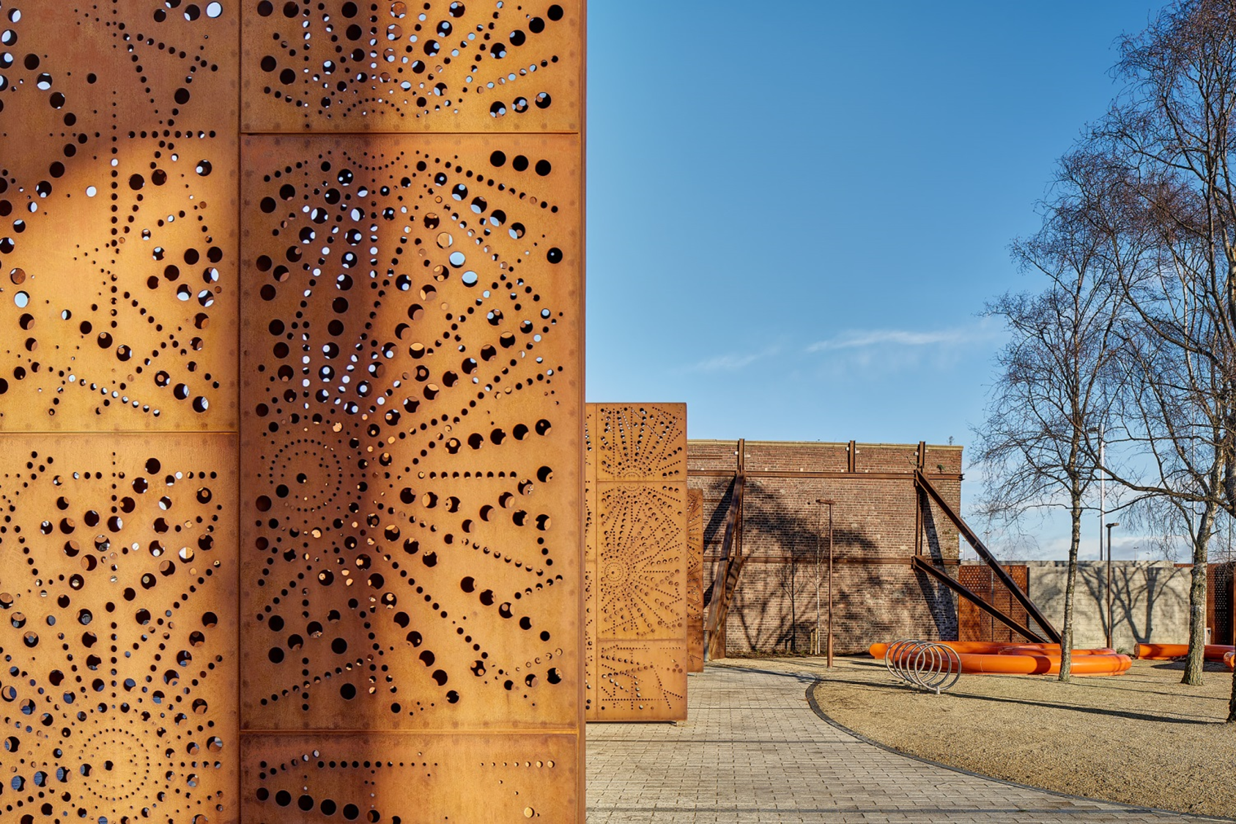
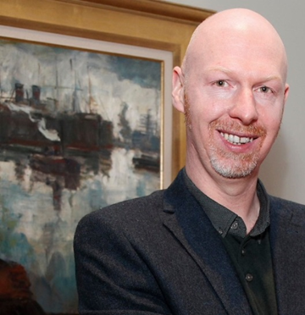
Dublin Port Company
Name: James Kelleher
Position: Head of Special Projects, Port Heritage & Communications
Contact: jkelleher@dublinport.ie
Short description of your citizen program(s)

Slide 2
Key Data of your citizen initiatives
Which actors do you usually collaborate with? Local community orgs, Local authority offices, Port Users and internal Stakeholders
Website with information about social activities (insert the link if you have): www.dublinport.ie ; dublinportarchive.com
Key Audience for your initiatives (children? general public? both?) Both
Social Initiatives you have recently developed | Year | Nº of visitors | Budget | Description
Tangible soft values - built environment | 2015 | Apx. 100,000 per annum | €0.55M | The Dublin Port Diving Bell
Tangible soft values project – built environment | 2016 | Apx. 4000 per annum | €0.5 M | Seafarers’ Centre
Intangible soft values- Arts - Music | 2018 | 50+ ‘x’ number outreach online | c. €5k | Hidden Pianos –Beneath the Quays
Intangible soft values – Arts Theatre, Plays | 2019 | tbc | tbc | In Our Veins and Last Orders at the Dockside plays in 2019

Slide 3
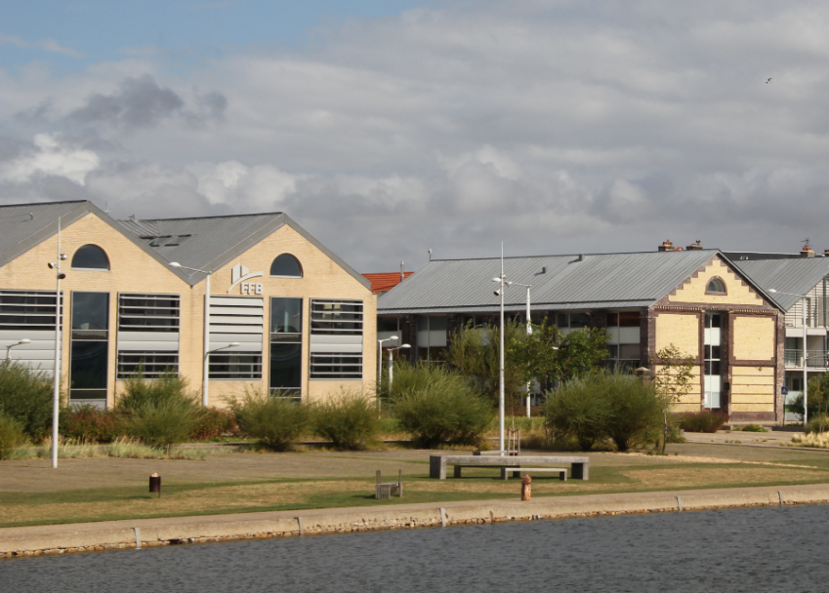
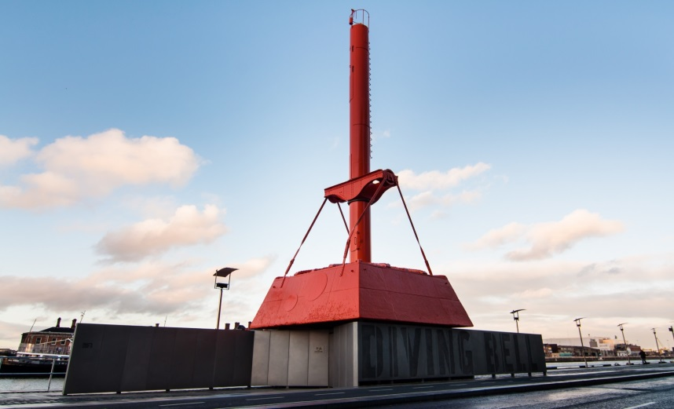
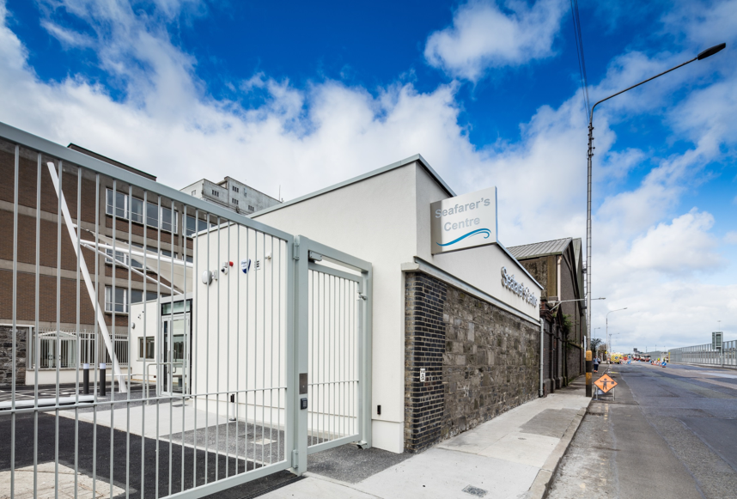
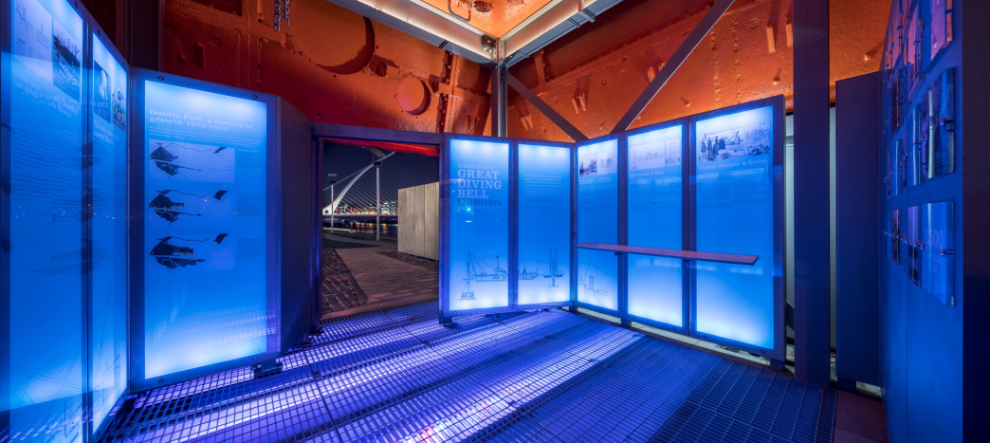
What have been the main difficulties to develop a citizen activities in your port city?
Example 1: Stakeholders, stakeholders . . . Don’t forget internal ones.
Example 2: Accessibility, health & safety constraints,
Example 3: Perception & recognition
Replace for photos of your Port City activities
Replace for photos of your Port City or activities
Key themes you would include in your future Port Center (if you plan one) or citizen activities
Theme 1: Heritage in all its facets
Theme 2: Modern port function
Theme 3: Environment, Biosphere
Replace for photos of your Port City activities

Slide 4
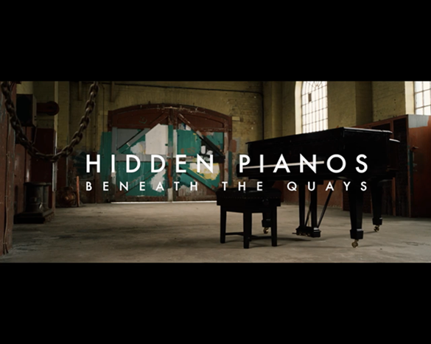
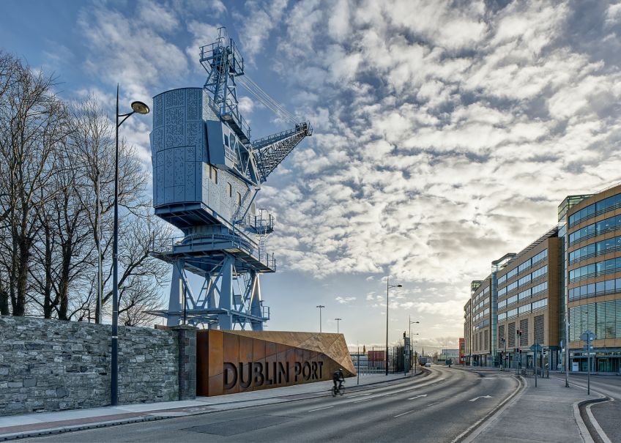
What are your goals/expectations for the PCN Meeting in Bilbao ?
…share/ receive knowledge and shared experience
…networking
…AIVP social and experiencing the port city of Bilbao
Replace for photo of your Port City
What useful knowledge should AIVP provide you with?
…Development of the Port
…Port city integrations projects
…Future contacts, delegates
Replace for photo of your Port City
Key topics for future PCN Meetings
…tbc
…
Replace for photo of your Port Center of Port City

