Slide 1
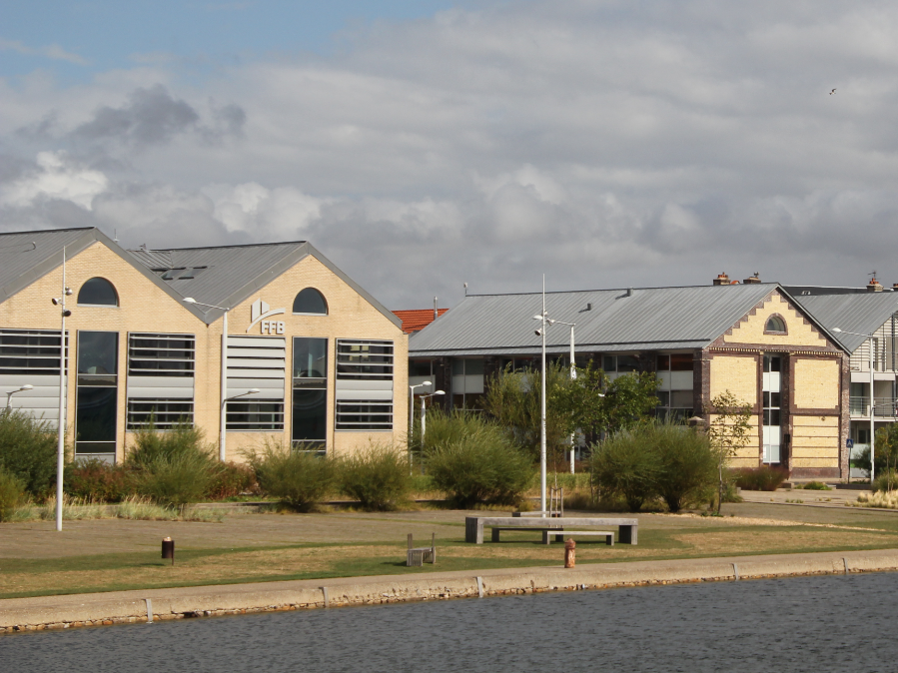
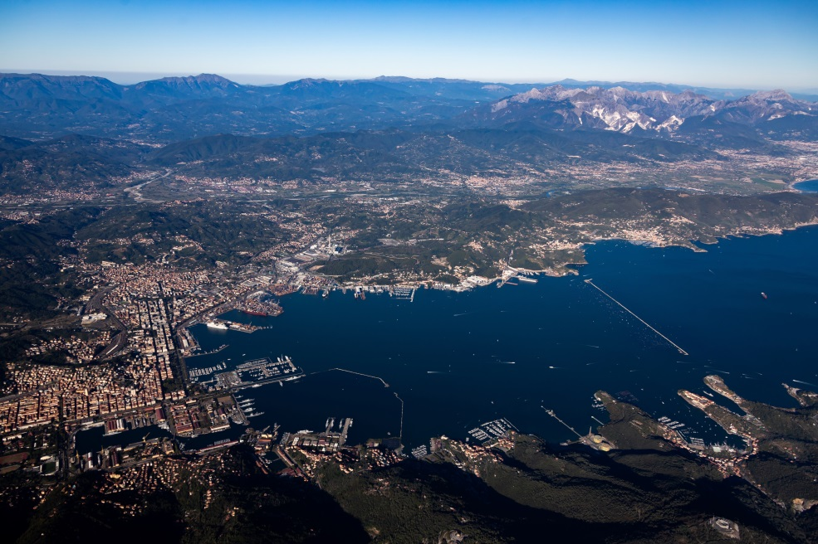
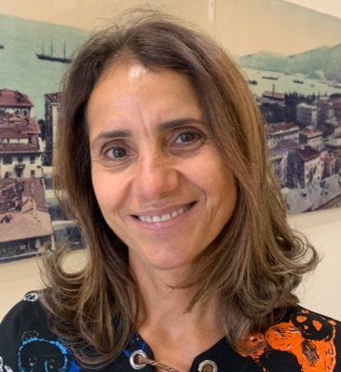
PORT AUTHORITY OF THE EASTERN LIGURIAN SEA, PORTS OF LA SPEZIA AND MARINA DI CARRARA
Name: Monica Fiorini
Position:Head of Communication, Promotion, Marketing
Contact: monica.fiorini@porto.laspezia.it

Slide 2
Key Data of your citizen initiatives
Which actors do you usually collaborate with? Municipality of Spezia, Contship Italia Group, Tarros Group, Grendi Group, Scafi Srl, Cost Guard of La Spezia and Coast Guard Marina di Carrara
Website with information about social activities : https://www.adspmarligureorientale.it http://www.portolab.it/home.php
Key Audience for your initiatives: children and general public.
Social Initiatives you have recently developed | Year | Nº of visitors | Budget | Description
Activity 1 | 2019 | 500 | € 5000,00 | Port Lab La Spezia
Activity 2 | 2019 | 400 | € 5500,00 | Port Lab Marina di Carrara
Activity 3 | 2019 | 600 | € 1000,00 | Port Days 2019
Activity 4 | 2019 | 3000 | € 30000,00 | Exhibition from the Mainland to the Promise Land Aliya Bet from Italy to Israel, 1945-1948

Slide 3
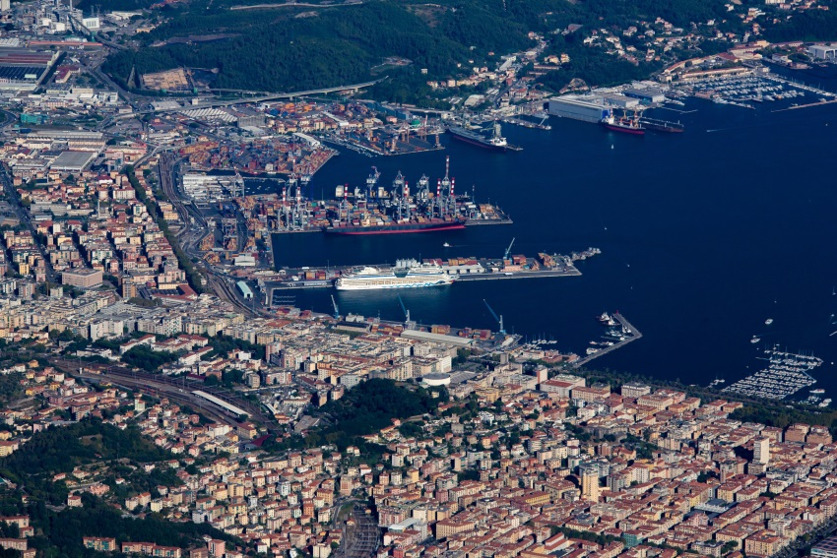
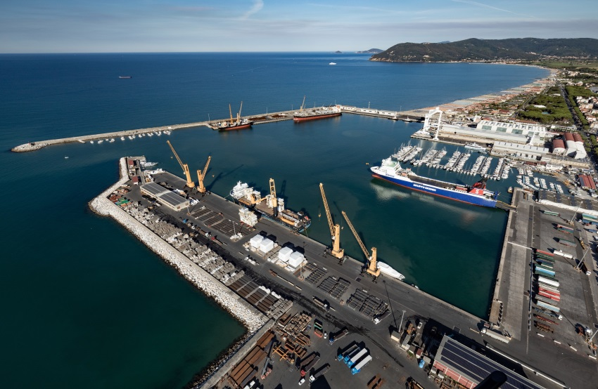
What are your goals/expectations for the PCN Meeting in Bilbao ?
To collect testimonials
To initiate contacts with the port center
Of other European Ports
What useful knowledge should AIVP provide you with?
Suggestions
Contacts
…
Key topics for future PCN Meetings
…
…
Replace for photo of your Port Center of Port City

Slide 4
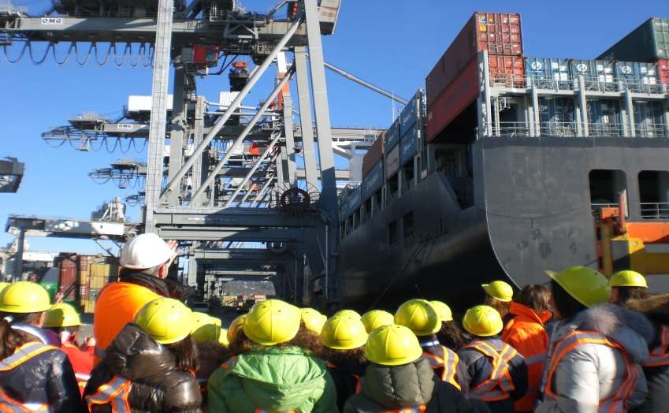
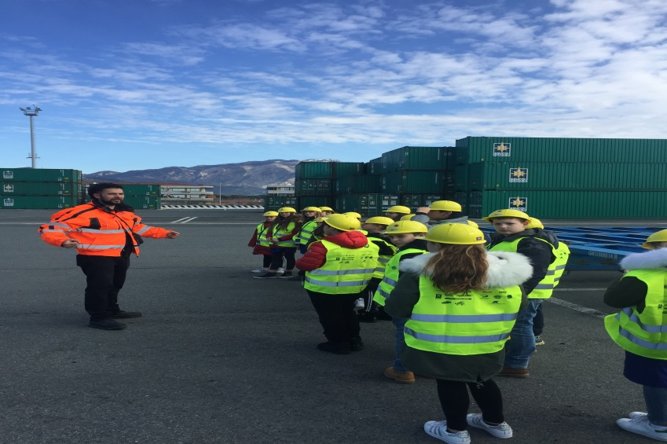
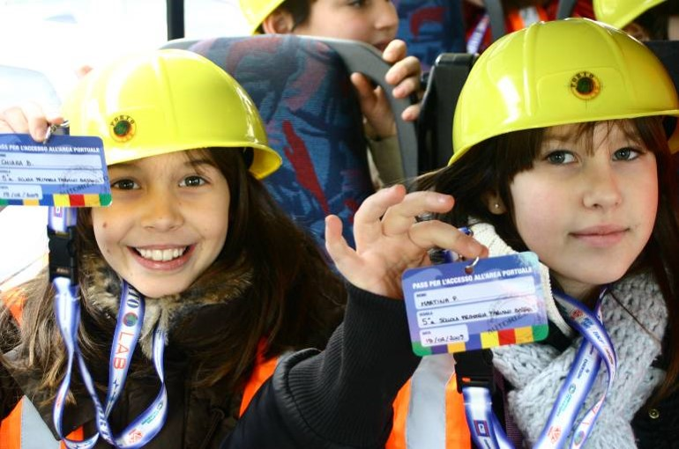
What have been the main difficulties to develop a citizen activities in your port city?
1 Economic support from private operators
Example 2
Example 3
Key themes you would include in your future Port Center (if you plan one) or citizen activities
1 Environmental sustainability of port activities.
2 Economic importance of the port’s activities
3 Maritime culture

