Slide 1
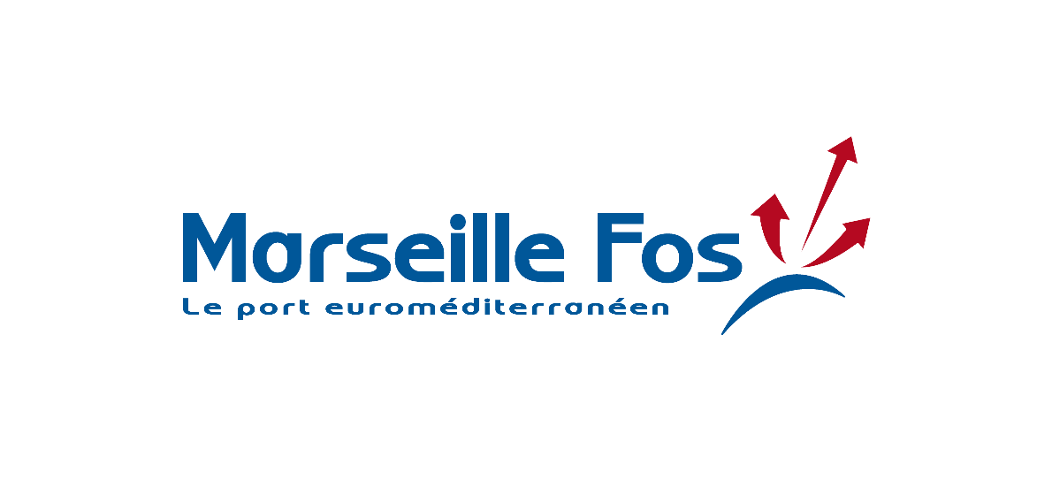
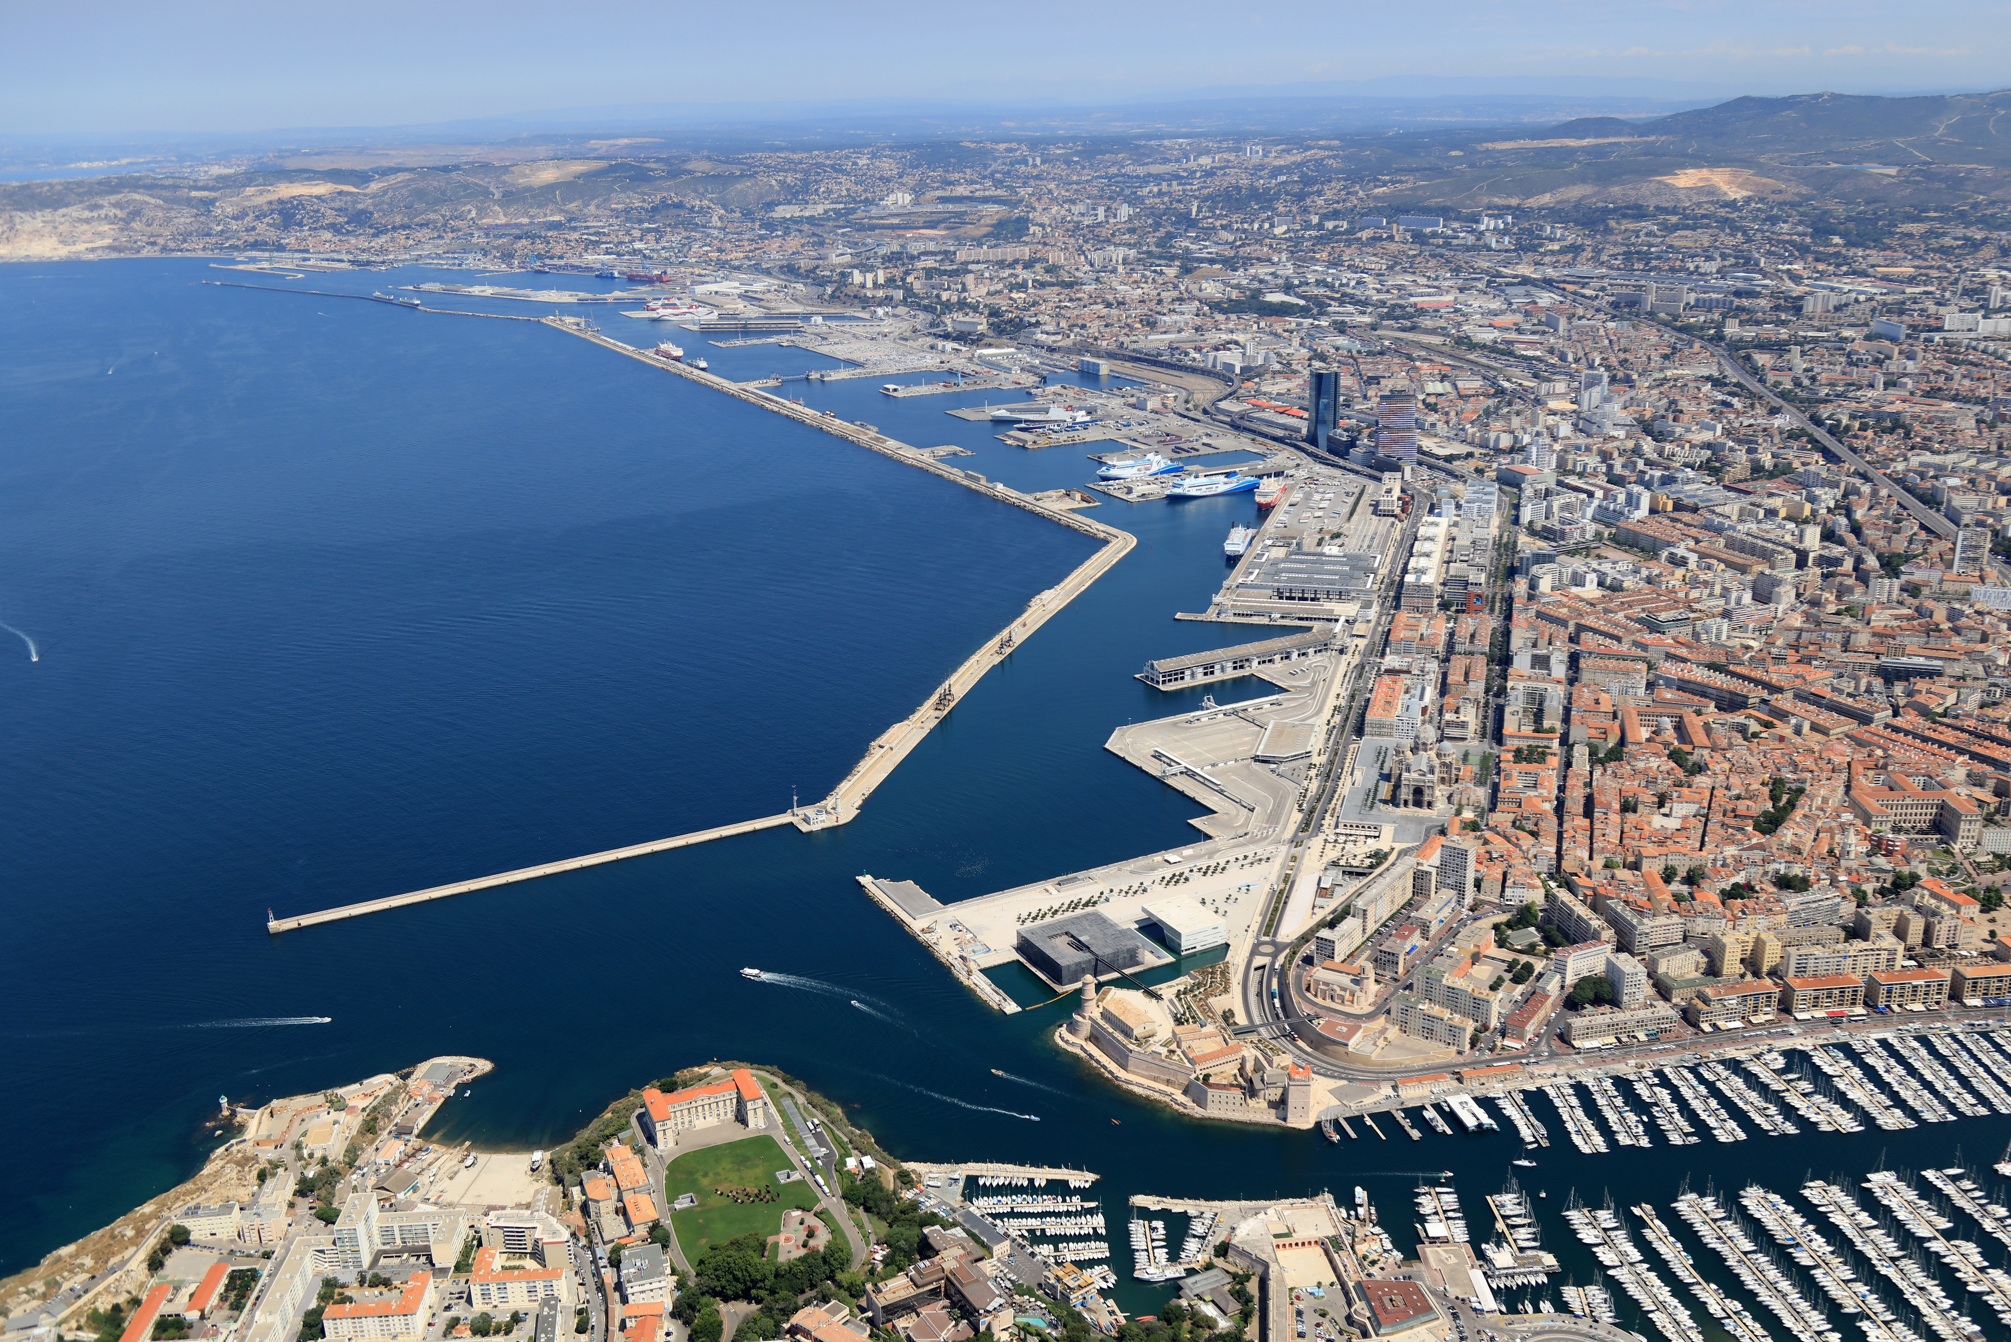
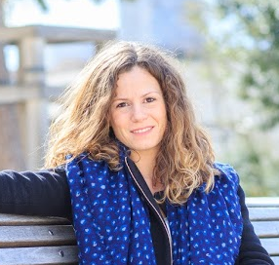
Grand Port Maritime de Marseille
Name: Claire Hallé
Position: In Charge of City-Port Partnership and Projects
Head Office / City-Port Department
Contact: claire.halle@marseille-port.fr
2 “Port Centers” in Fos
No “Port Center” yet in Marseille

Slide 2
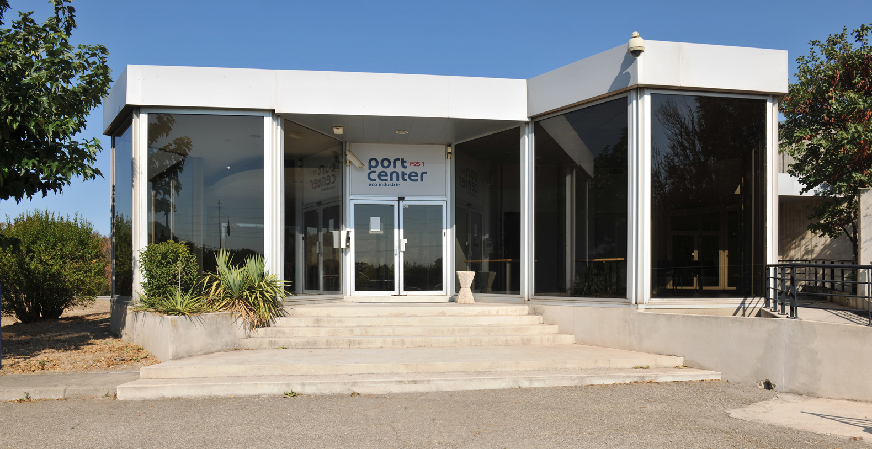
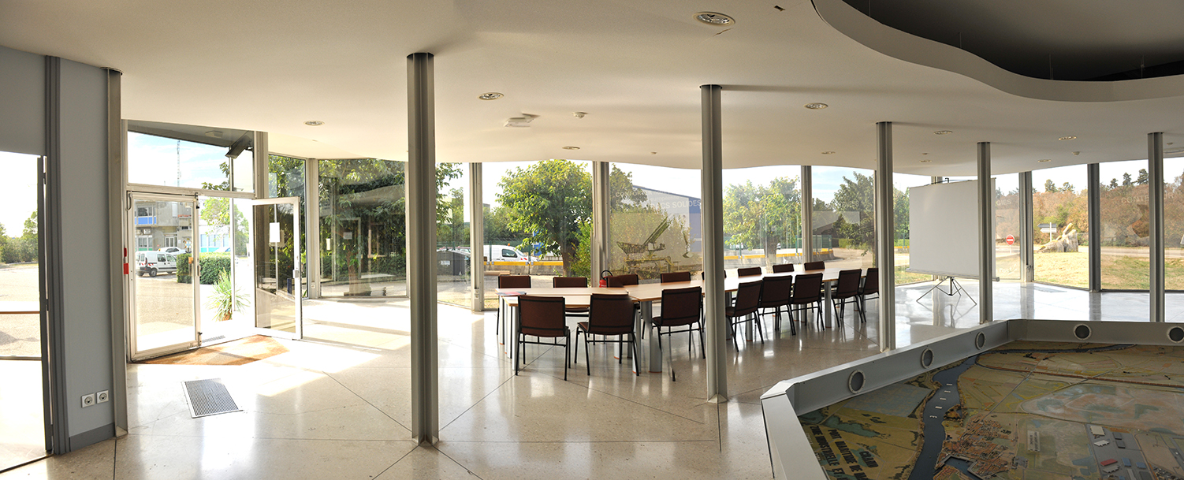
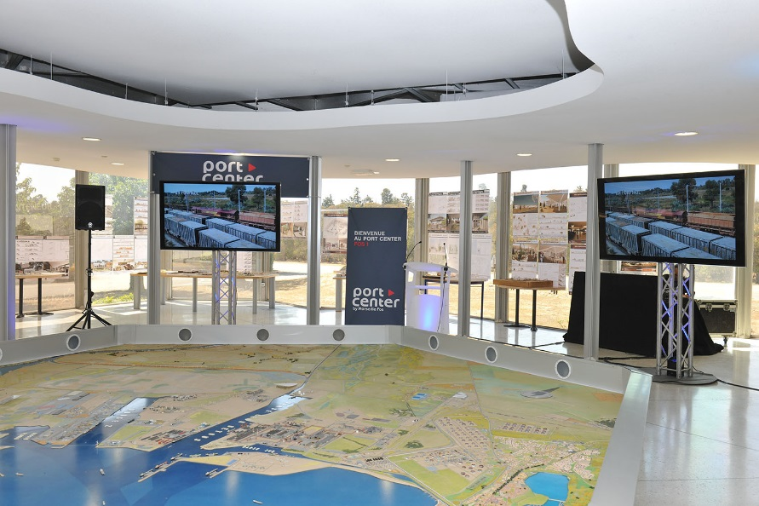
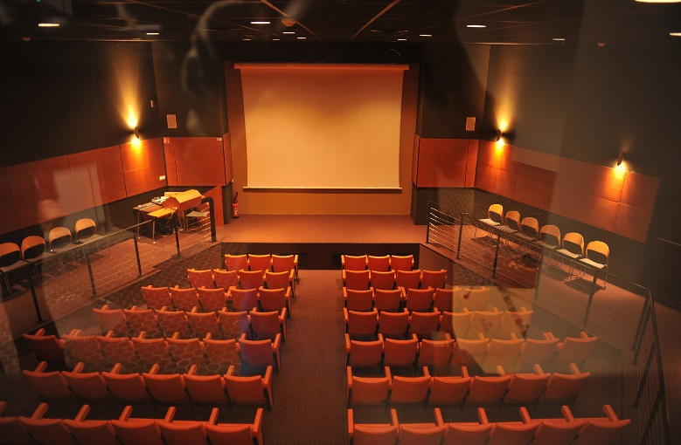
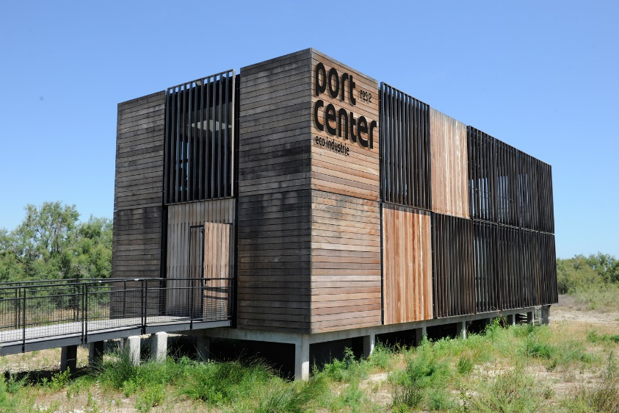
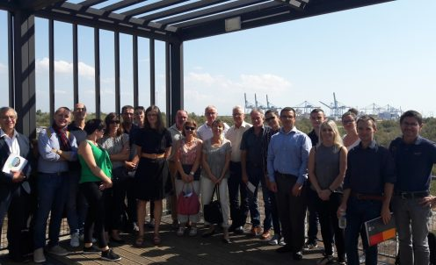
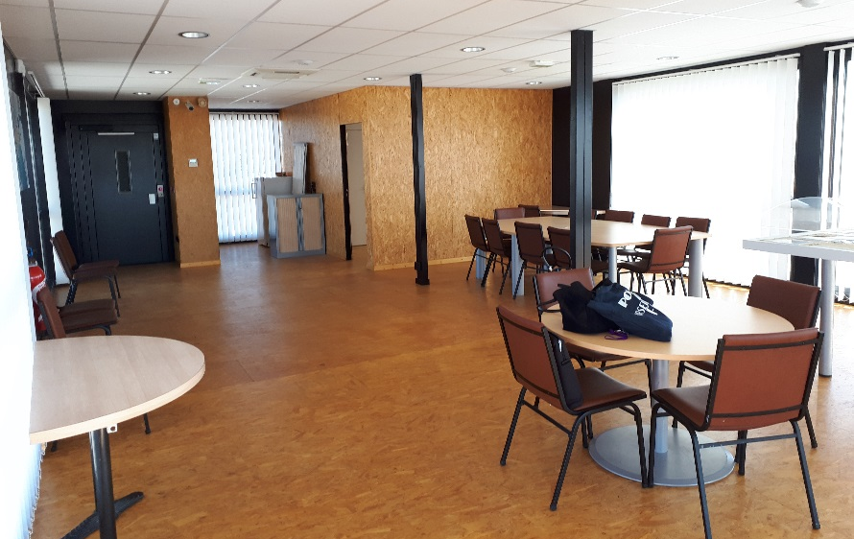
Key Data of Fos Port Centers
On Thursday, September 14, 2017 the port of Marseille Fos, the Chamber of Commerce and Industry, the Department, the Metropolis as well as the cities of Marseille, Port-Saint-Louis-du-Rhone, Port-de-Bouc and Fos- sur-Mer have signed "the charter missions of a port center" alongside the AIVP, the international association of port cities.
Your Port Center (building or platform): Port Center Fos 1 & Port Center Fos 2
Year of creation:
PCF1 : built before 1980 (“CIPAM”), renamed “Port Center Fos 1” in 2016, and renovated in 2019
PCF2 : built in 2010 (“Pavillon 2XL”), renamed “Port Center Fos 2” in 2017
Actors involved (or approached): On September 15, 2017, partners of the Continuous Concertation were invited to show their adherence to the principles of the charter edited by the AIVP and to support the actions of appropriation of the port reality by the citizens, for the sustainable development on the territory city port
Website (insert the link if you have): -
Audience (children? general public? Students ? All of them?): visitors and professionals
Types of use : reception of delegation before any visit of the Fos harbor area ; training session of the Port Institute; meeting as part of the ongoing consultation of the port; greetings to agents; meetings for GPMM managing staff ; colloquia; press conferences ; customer appointments.
Equipment :
PCF1 : exhibition room + harbour and industrial area model + auditorium
PCF2 : wood building with view on the Fos container terminal and the Distriport logistic area : meeting room + industrial area model
 | 2017 | 2018 | 2019
Nº of visitors | PCF1 ≈ 4000/year
N° of days of use | PCF1 = 162 | PCF1 = 158 PCF2 = 27 | PCF1 = 76 PCF2 = 77

Slide 3
Key Data of other citizen initiatives
Which actors do you usually collaborate with? Local authorities (city, county, district…), state services, port community, university…
Website with information about social activities (insert the link if you have): https://www.marseille-port.fr/fr/Accueil/
Key Audience for your initiatives (children? general public? both?) : both
Social Initiatives you have recently developed | Year | Nº of visitors | Budget | Description
Port Open days | last edition in 2013 | more than 10000 each year it took place | ≈ 110K€/year | Free guided tours on boats of both Marseille and Fos harbours during 3 days each year This year : https://inscriptions.usineextraordinaire.com/bienvenue
Group visits | For more than 20 years | More than 2000 each year | 2 full-time equivalent | Possibility to visit both Marseille and/or Fos harbour with a free GPMM guide (the group who wants to visit has to provide a bus or boat) : https://www.marseille-port.fr/fr/Page/16461
Consultation meetings about city-port topics | since 2010 since 2019 | > 3 x 3 ateliers entre sept. Et nov. 2019 | > > | For the Fos industrial Port Area : “concertation continue” since 2010 (workshops organised by the GPMM Conseil de Développement) : http://www.marseille-port.fr/fr/Page/18341 For Marseille : “dialogue ville-port” since 2019 : https://www.dialoguevilleportmarseille.fr/
Toll free | 2019 2015 | > 203 calls | > > | To inform people and collect questions and complaints about port activities For the Fos industrial Port Area : ZIP-COM 06 08 96 33 54 For Marseille : numero vert Bassins Est 0800 007 091

Slide 4
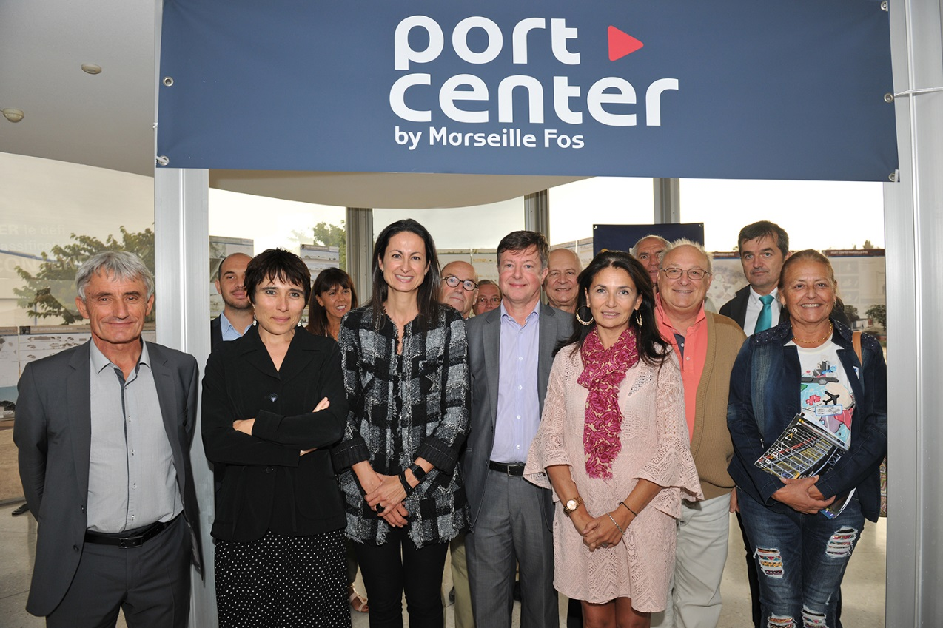
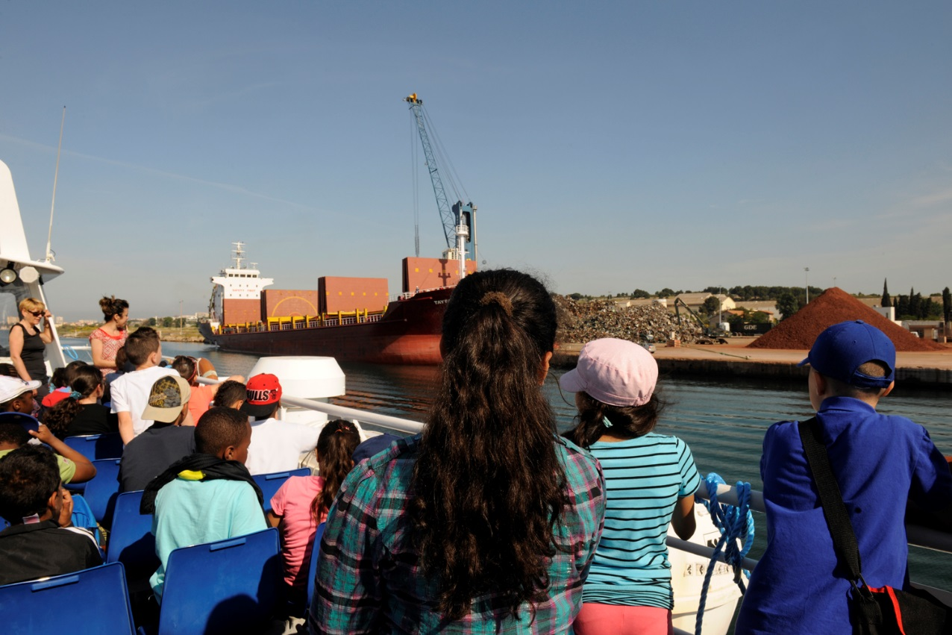
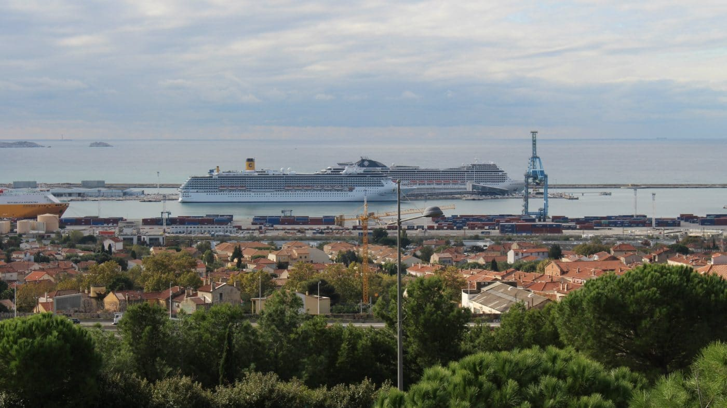
What have been the main difficulties to develop a citizen activities in your port city?
Financial considerations
Lack of ressources to run and animate the “Port Centers”
Intern organisation...
Key themes you would include in your future Port Center (if you plan one) or citizen activities
Explaining the port to children and students, its activities, the main development projets (both industrial and city-port projects), its economic impacts on territory
Jobs and especially new jobs linked to digital and energetic transitions
Guided tours to discover concretly how the port works and lives
…

Slide 5
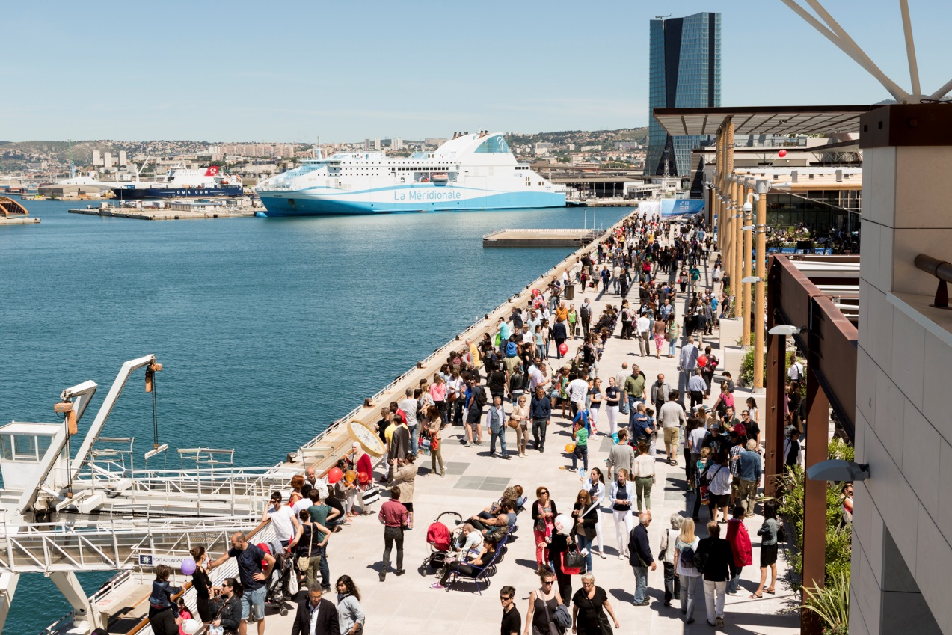
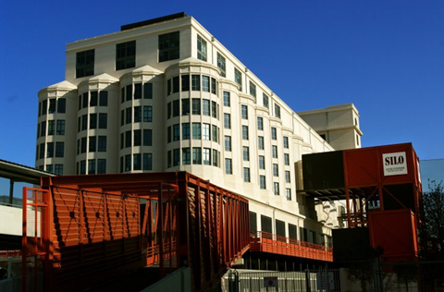
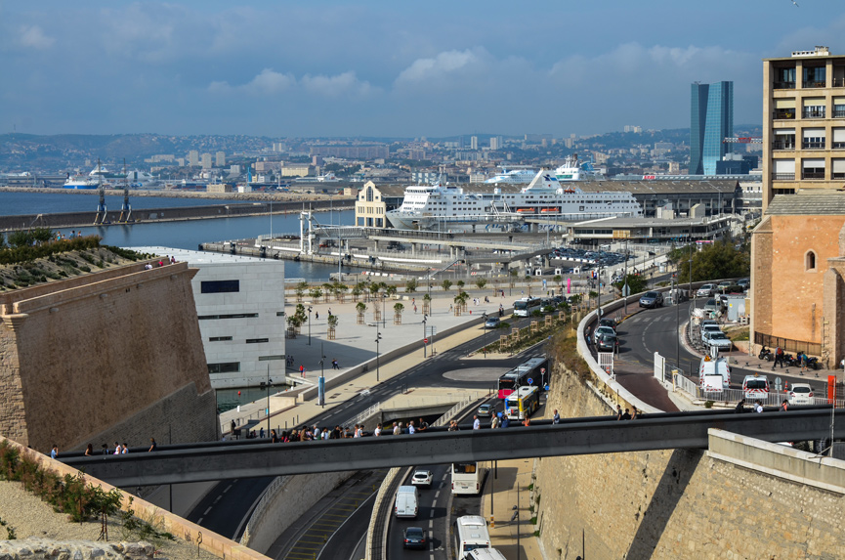
What are your goals/expectations for the PCN Meeting in Bilbao ?
To discover what other city-port communities are doing / developing
To meet Port Center referents / people in charge of other port/territories and discussing ideas / difficulties with them, exchanging experience
…
What useful knowledge should AIVP provide you with?
Benchmark
Port Center business models / exemples of ressources…
Help to structure institutional partnerships
Key topics for future PCN Meetings
Port Center business models and juridical structuration
Use of new technologies in Port Centers
…

