Slide 1
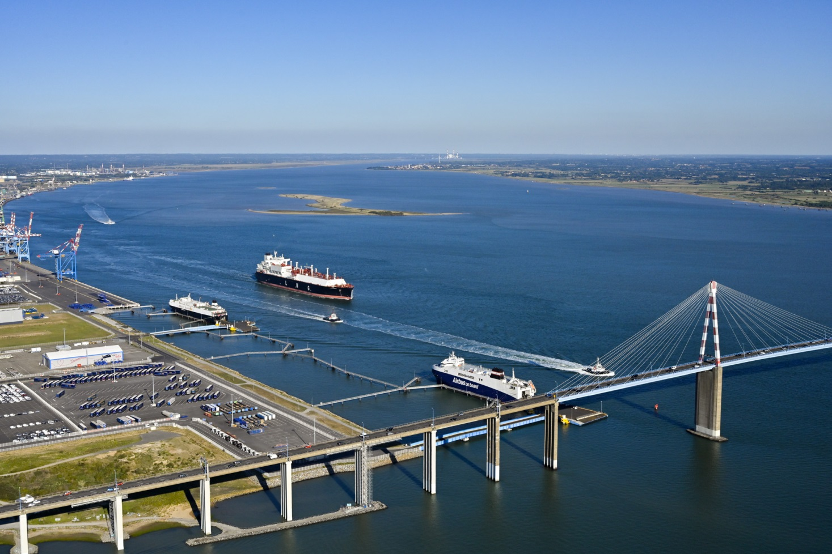
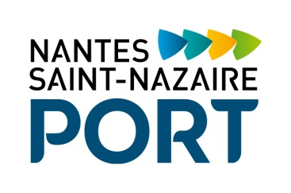
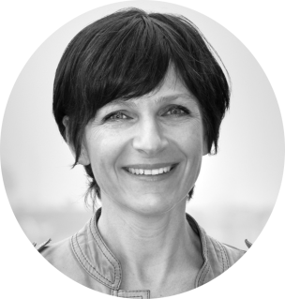
Nantes Saint-Nazaire Port
Name: Karine Lerendu
Position: Communication Department Manager
Contact: k.lerendu@nantes.port.fr
In 2018, 29 000 visitors discovered the Loire estuary and the port facilities, with the Tourism Offices and associations. In parallel with these visits, actions are carried out around public events like The Bridge, Débord de Loire, la Mer XXL...

Slide 2
Key Data of your citizen initiatives
Which actors do you usually collaborate with? Tourist Offices in Nantes (A Journey to Nantes) and in Saint Nazaire (Saint Nazaire Tourism). Associations like Estuarium or Cultural and Maritime Center of Nantes…
Nantes - Saint Nazaire Port is a founder member of the "Visitez nos entreprises en Pays de la Loire" ("Visit Our Companies in Pays de la Loire") Association.
Website with information about social activities (insert the link if you have):http://www.nantes.port.fr/about-the-ports-activities/visiting-the-port/?L=1
Key Audience for your initiatives (children? general public? both?) : Both. The main public is the people who live in Loire Estuary.
Social Initiatives you have recently developed | Year | Nº of visitors | Budget | Description
Coach tours of the Saint Nazaire, Montoir de Bretagne and Donges facilities | 2018 | 2069 |  | individuals and organized groups - duration: 2 hours
Saint Nazaire sea cruises | 2018 | 5120 |  | From April to September. An exploration by sea of the port facilities from Saint Nazaire to Donges (individuals and organized groups - duration: 2 hours)
Loire Estuary cruises | 2018 | 19577 |  | From Nantes to the port of Saint-Nazaire you will see unique points of view on the villages, the flora and fauna, the works of the estuary route. On board, a guide comments your discovery: the places, their stories, their stakes ...
Cultural and Maritime Center of Nantes | 2018 | 846 |  | Cruise to discover the industrial heritage of the Loire estuary
Estuarium | 2018 | 900 |  | Educational program to discover the Loire estuary : natural landscapes, industry, activities
Discovery of natural aera of Donges | 2018 | 52 |  | Discovery of the management of natural areas: biodiversity, migratory flows of birds, agricultural activity, hunting…

Slide 3
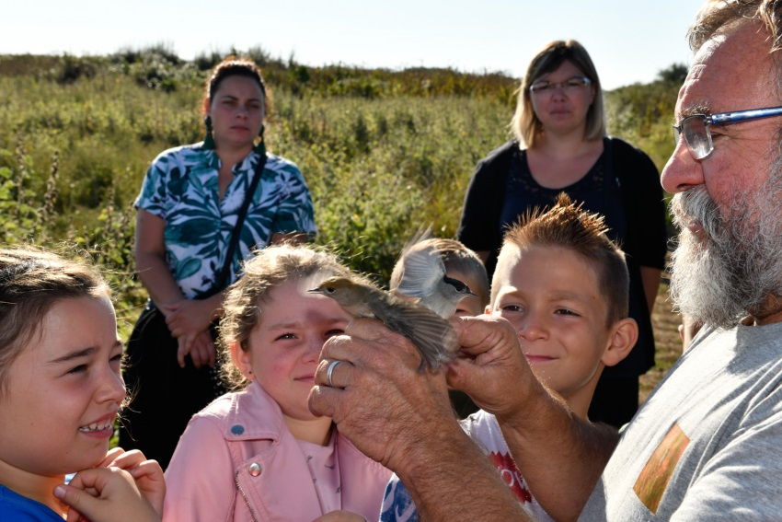
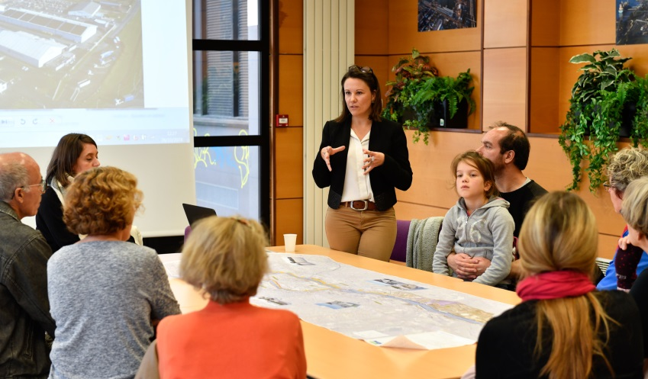
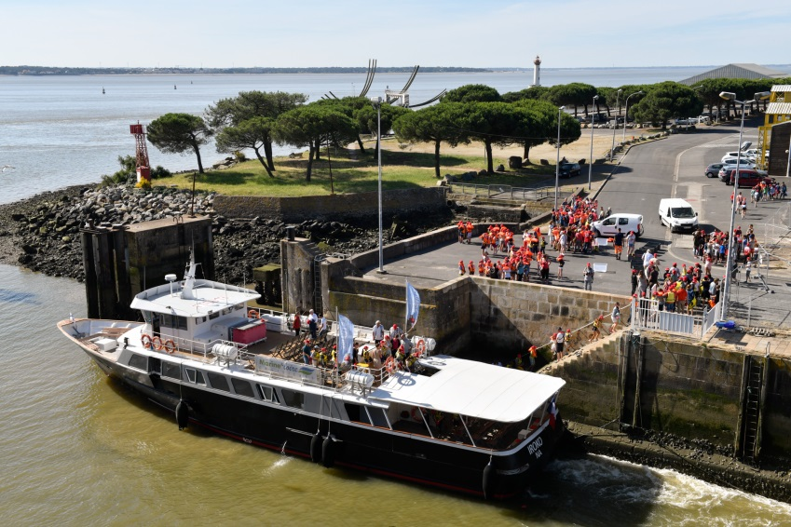
What have been the main difficulties to develop a citizen activities in your port city?
The availability of professionals and the adaptation of the speech
Internal mobilization
Replace for photos of your Port City or activities
Key themes you would include in your future Port Center (if you plan one) or citizen activities
Port professions
History and projects
Issues and role
Replace for photos of your Port City activities

Slide 4
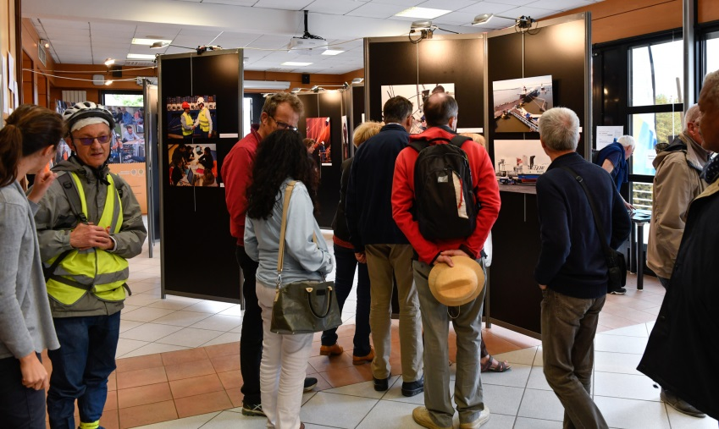
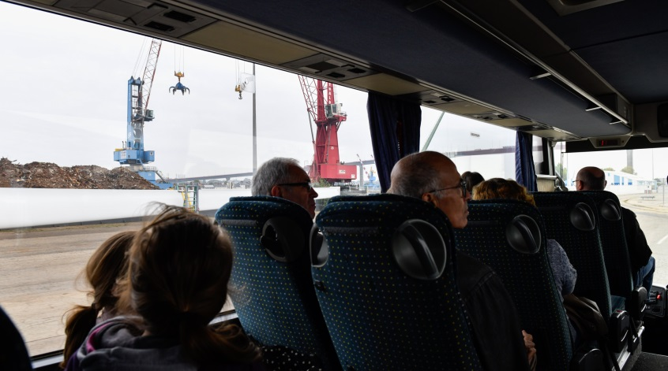
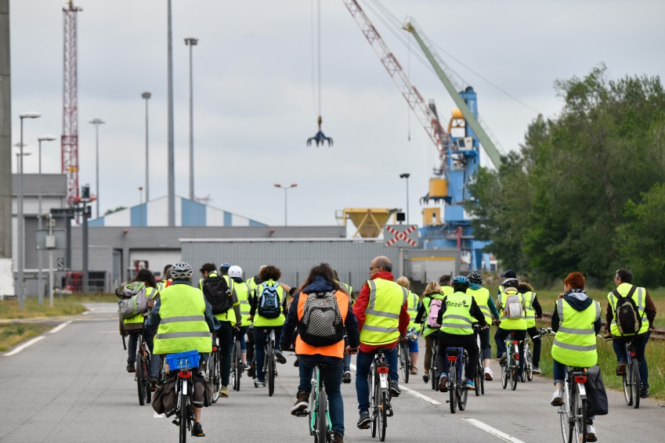
What are your goals/expectations for the PCN Meeting in Bilbao ?
Discovery
Experience sharing…
Replace for photo of your Port City
What useful knowledge should AIVP provide you with?
approach, method, risks, levers…
Replace for photo of your Port City
Key topics for future PCN Meetings
…
…
Replace for photo of your Port Center of Port City

