Slide 1
Planning a multimedia Port Center in
The Port of Oslo
Name: Åsa Nes
Position: Director of Property
Contact: + 47 913 40 870
asa.nes@oslohavn.no
Name: Siv Ellen Omland
Postition: Head of Communication
Contact: + 47 951 05 489
siv.ellen.omland@oslohavn.no

Slide 2
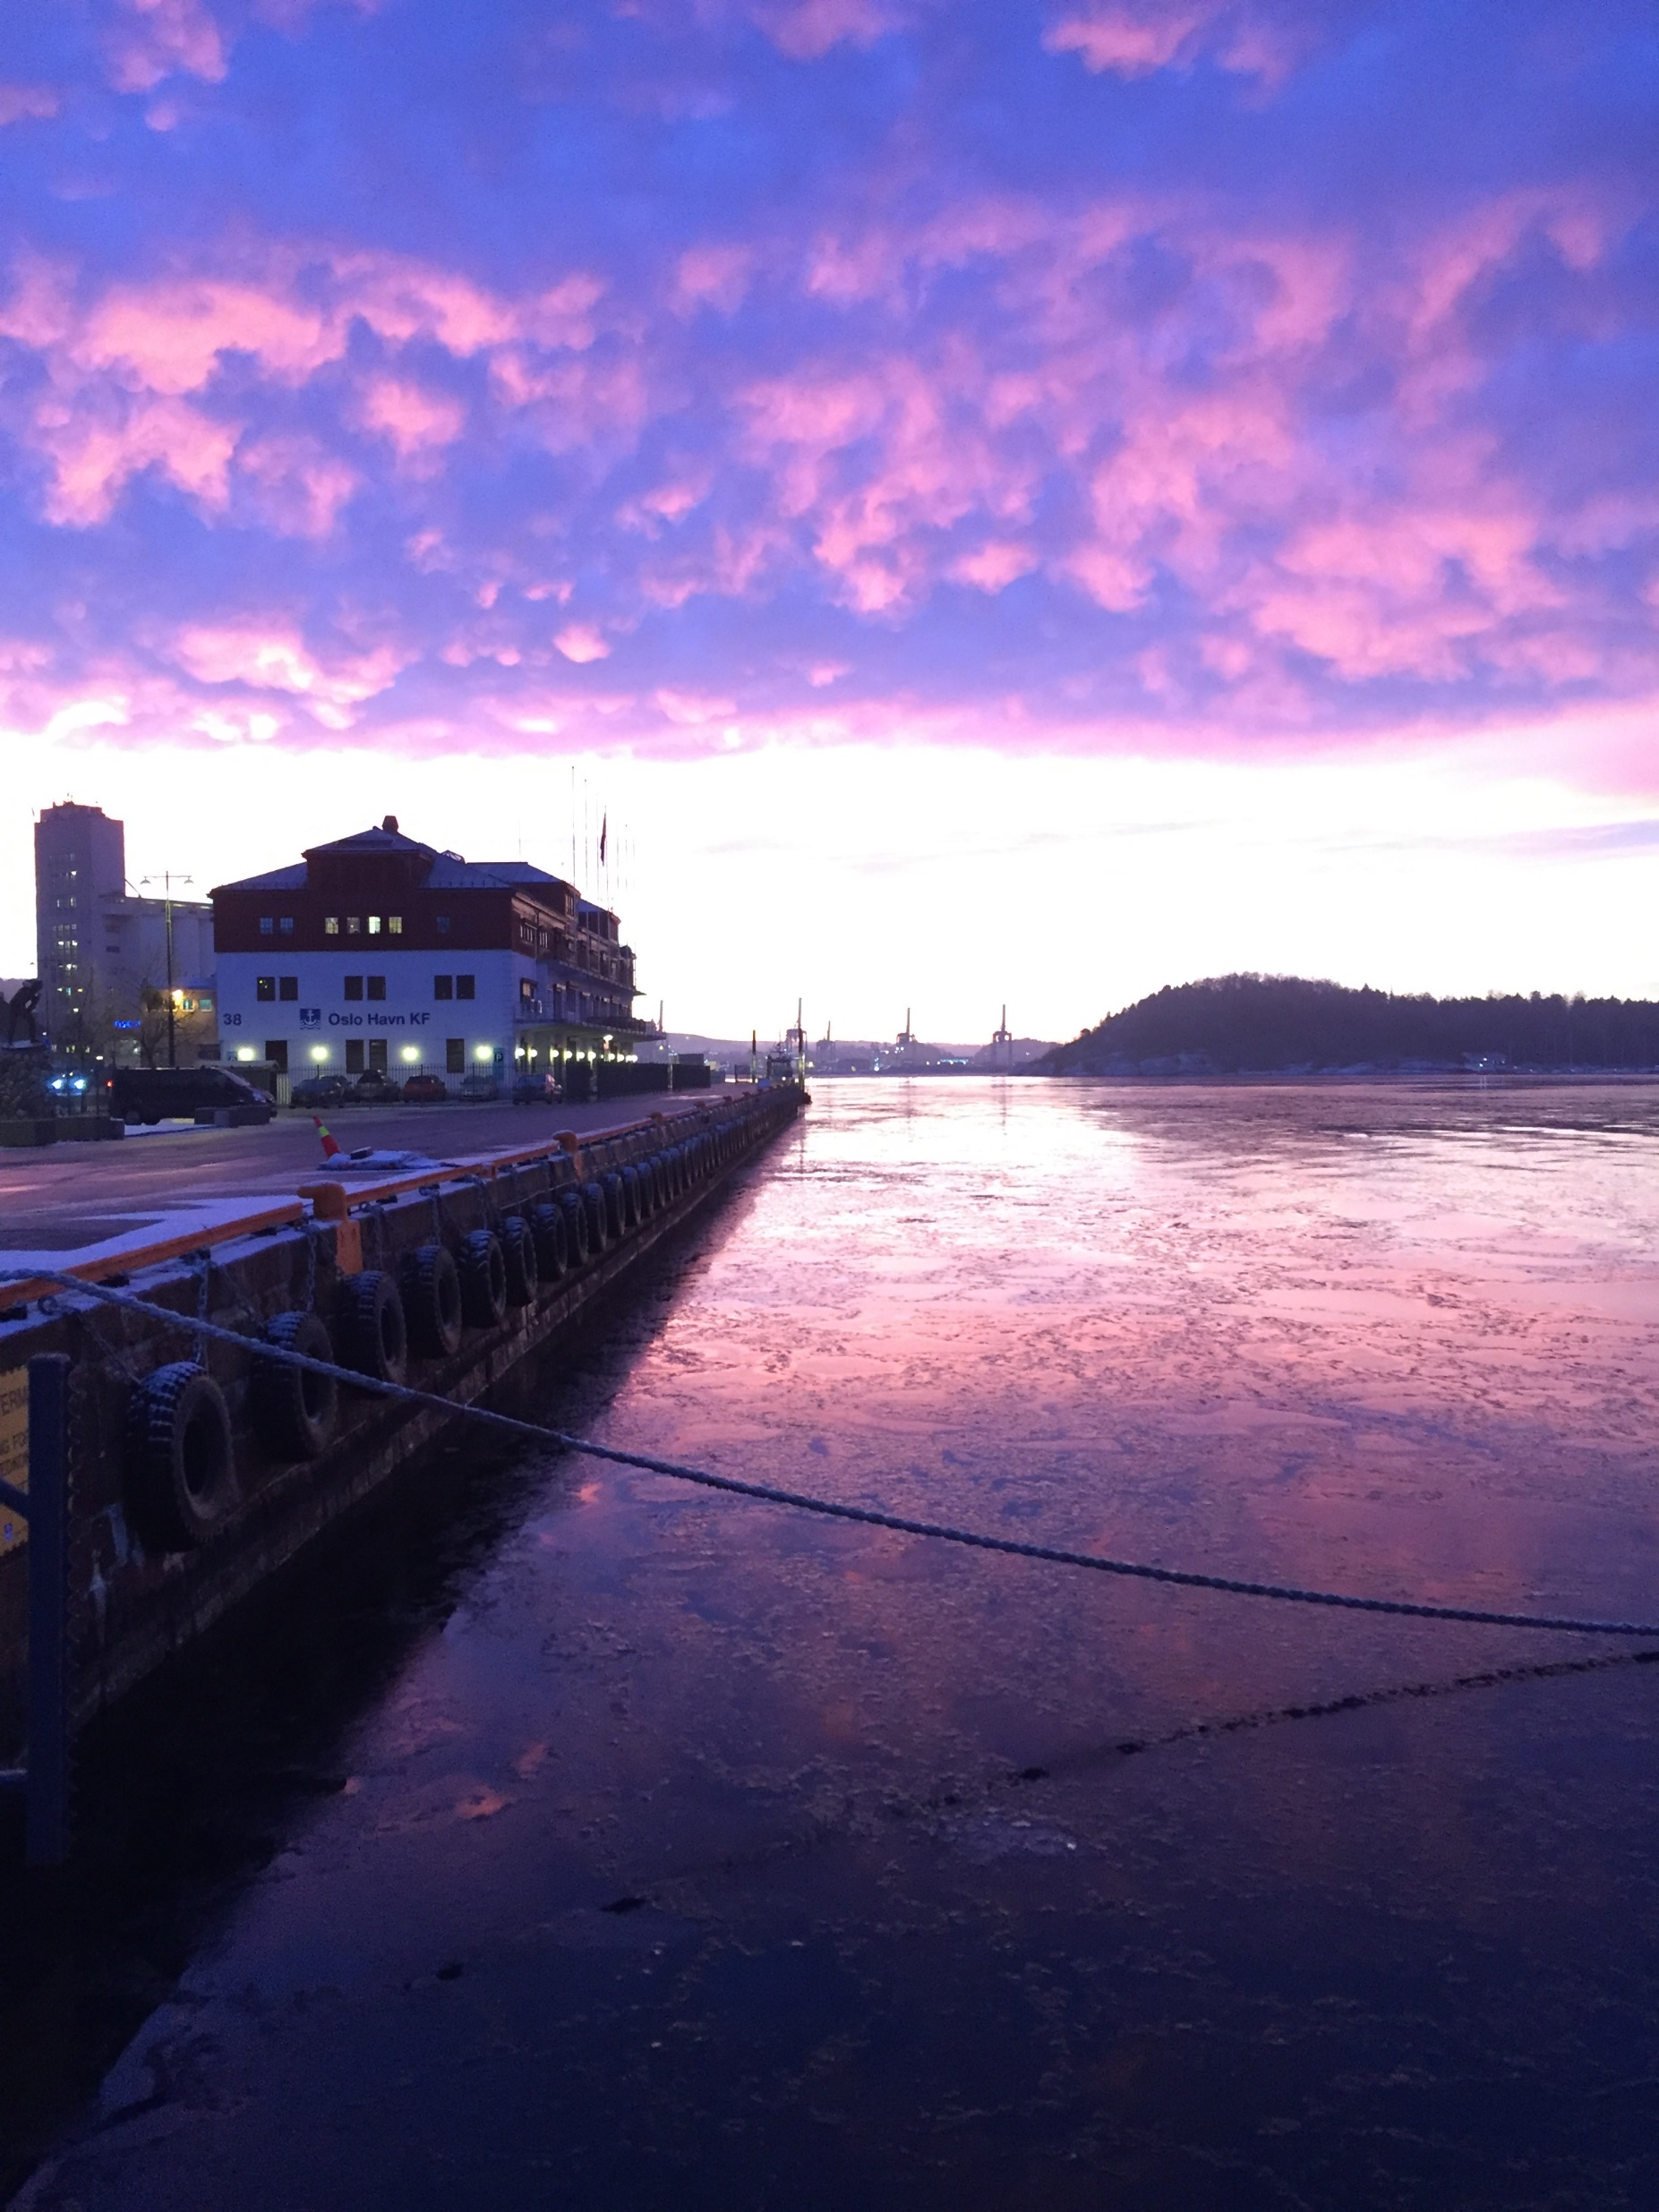

Slide 3
Key Data of our citizen initiatives
Actors: The Port Walk in cooperation with customers and Port related organizations.
Website: https://www.oslohavn.no
Key Audience: Families of all ages in the city
Social Initiatives you have recently developed | Year | Nº of visitors | Budget | Description
 | 2019 |  |  | The European Commission awarded Oslo the prestigious European Green Capital title for 2019. We have received a lot of delegations and journalists from all over the world to learn about The Port of Oslo.
 | 2014-2019 |  |  | Port Walk – 10 000 citizens enjoy activities along the 9 km harbour promenade.
 | 2010- 2017 |  |  | Boattrips with neigbours and students
 | 2019 |  |  | Planning and celebrating 3 parks and a new shore power station

Slide 4
We need a Multimedia Center
What have been the main difficulties to develop a citizen activities in your port city?
No difficulties. The citizens of Oslo love the activity in the port.
For The Port of Oslo it is a question of priority and how to learn and entertain people.
Key themes to include in our future Port Center
Make the citizens understand the importance of The Port of Oslo.
Environmental port issues
Property developement

Slide 5
Goals, expectations and knowledge
For the PCN Meeting in Bilbao
Get inspired
Learn from other ports
Useful knowledge AIVP can provide us with
We need good ideas
Learn about the possibilities

Slide 6
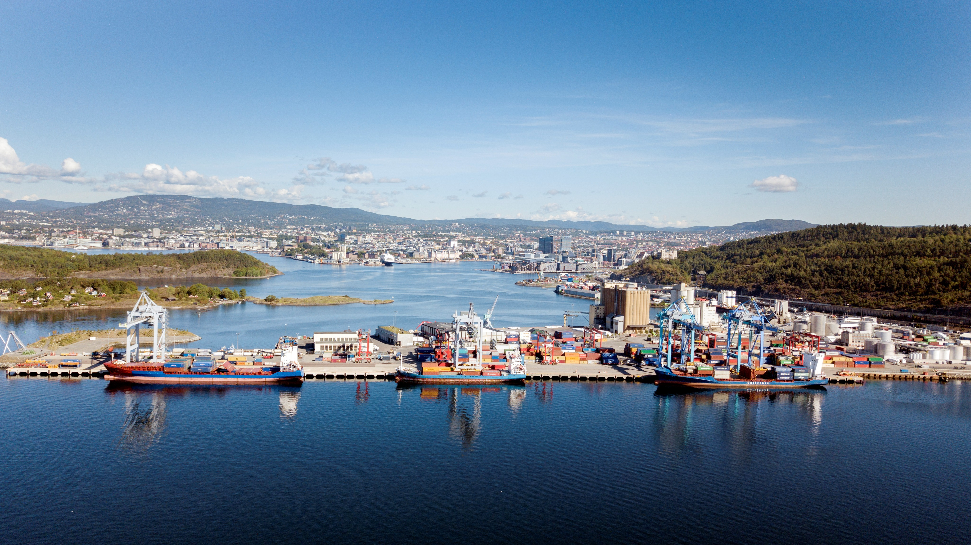

Slide 7
We make a yearly Port Walk with activitis

Slide 8
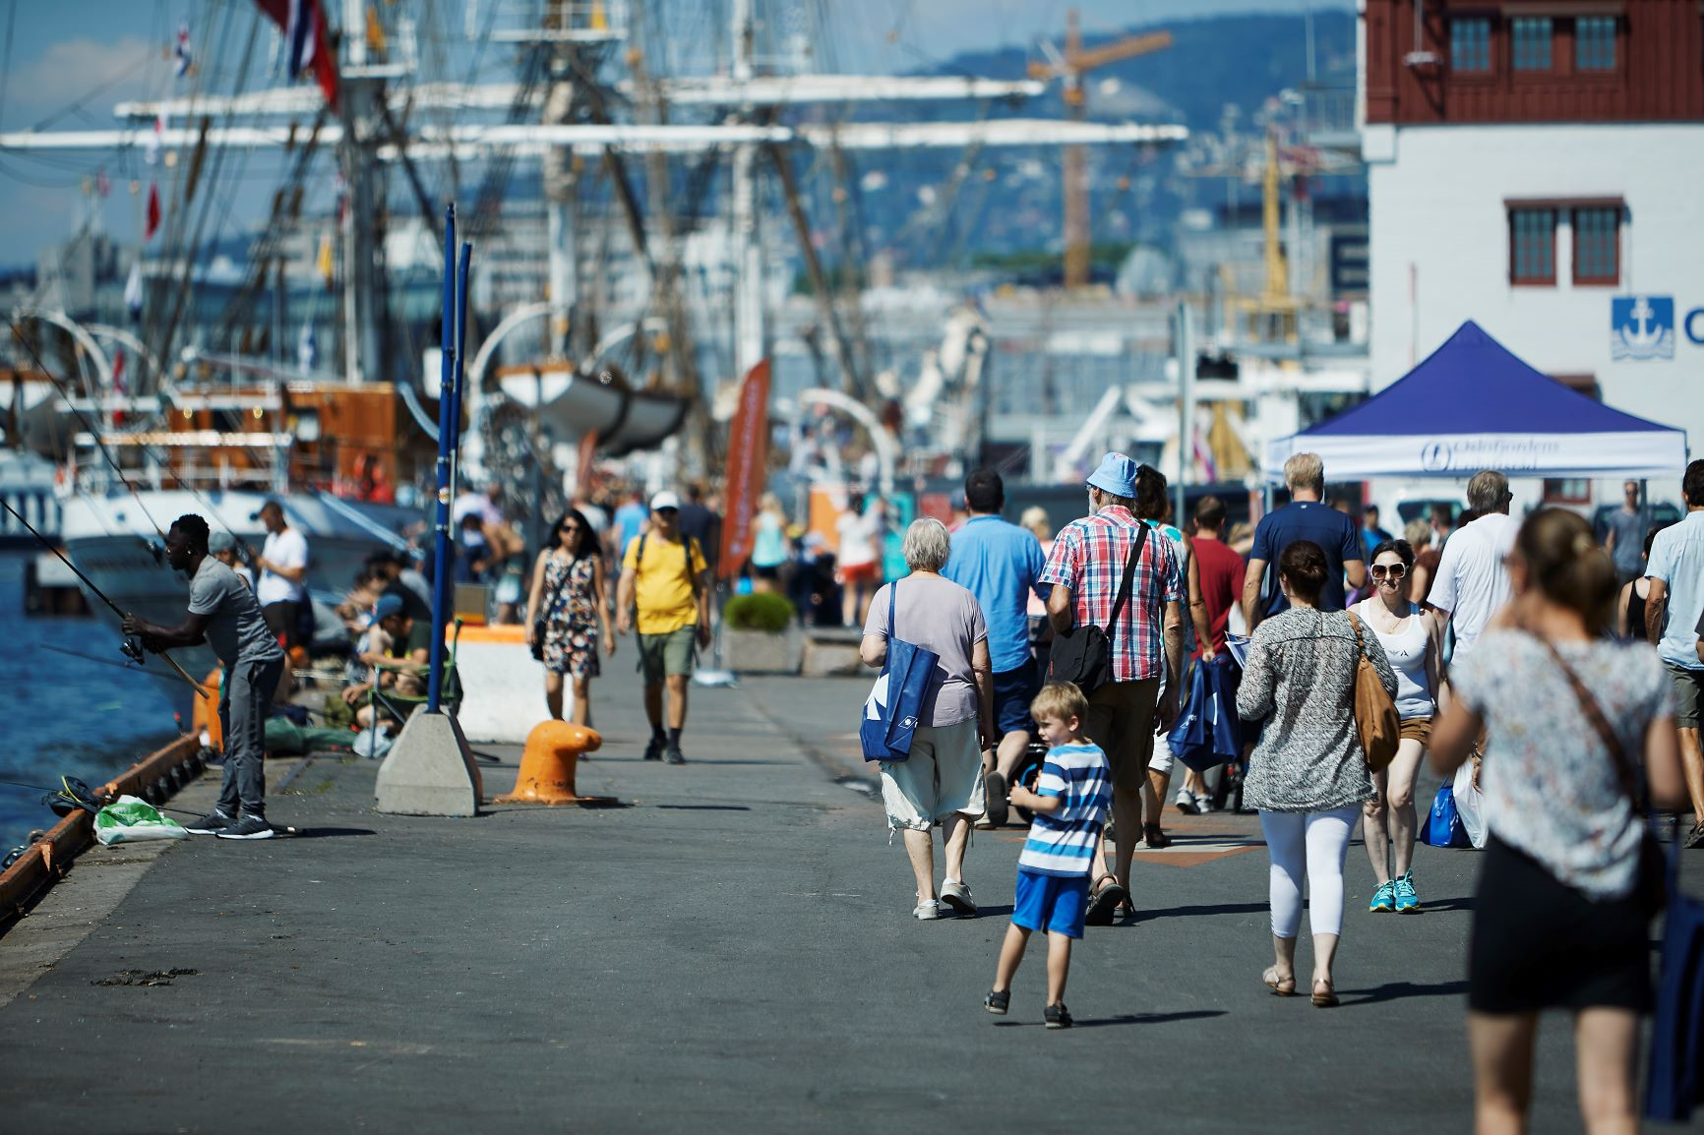

Slide 9
Port Walk Parkour

