Slide 1
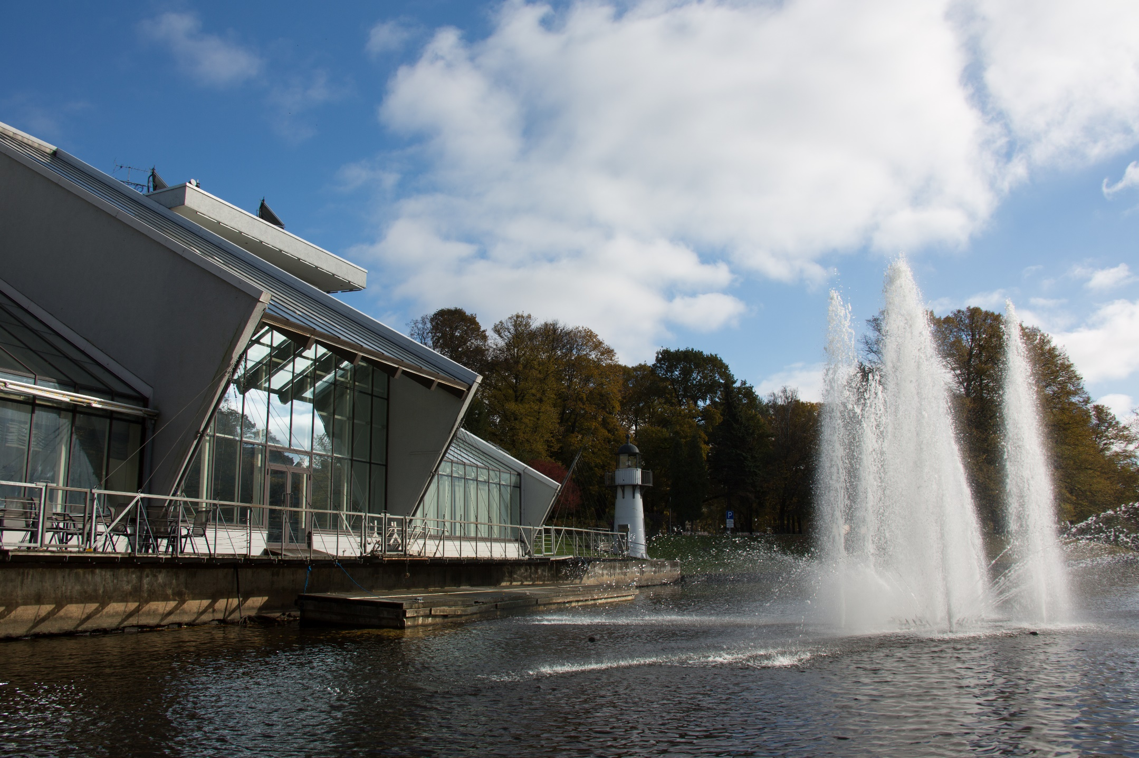
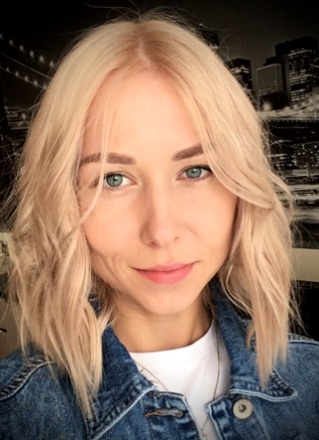
Freeport of Riga Authority
Name: Kristine Birgele
Position: Specialist of Administrative department
Contact: kristine.birgele@rop.lv
linkedin.com/in/kristine-birgele
Every year Freeport of Riga Authority (FRA) organizes and supports social, educational, cultural and sports events for the residents and visitors of the city.

Slide 2
Key Data of your citizen initiatives
Which actors do you usually collaborate with? Port neighborhood communities, schools and universities
Website with information about social activities (insert the link if you have): www.rop.lv
Key Audience for your initiatives (children? general public? both?): both
Social Initiatives you have recently developed | Year | Nº of visitors | Description
«Big Clean-Up» | every year | ~ 200 | For the eleventh year, the Freeport of Riga Authority is also participating in the Big Cleanup where FRA staff help to clean up the port neighborhood areas. E.g. this year during the clean-up, old, uninhabited buildings were demolished, household waste was discharged from the area adjacent to the port, and more than 50 trees were planted with the residents of Kundzinsala neighbourhood. A total of 120 cubic meters of waste and 5 tons of used car tires were collected.
Competition for schoolchildren in the neighborhoods adjacent to the Freeport of Riga | 2019 | ~ 380 | From September 15 to October 3, 2019, the Freeport of Riga Authority organized cycle of 7 excursions by boat across the Freeport of Riga in order to promote cooperation between the port and city residents, as well as to raise young people's understanding of the port activity. Within the framework of this project, we have addressed several educational institutions located in the territories adjacent to the port. At the end of the cycle, the most attractive class (Facebook activity) and the class teacher will have the opportunity to go on a cruise to Stockholm.
Port Festival | every year | ~ 120 000 | In the framework of annual Riga City Festival FRA organizes the Port Festival that includes many attractive and family friendly activities, surprises and opportunities to win valuable prizes as well as events such “Canal Regatta” and 24h long basketball tournament “Coast Match” with the participation of FRA staff. As a novelty - at the FRA main building there is an interactive educationally entertaining booth “Aquatorium” and the special musical fountain and water light show.

Slide 3
Key Data of your citizen initiatives
Social Initiatives you have recently developed | Year | Nº of visitors | Description
Blood Donor Days | every year | - | Every year in cooperation with the State Blood Donor Center and basketball club “VEF Riga” FRA organizes Blood Donor Days in the main FRA office. All the participants are very much aware of the importance of blood donation and are happy to make such contribution on the state level. Each blood donor receives an additional invitation to the VEF Riga game for two and a piece of VEF anniversary cakes.
Landscaping works of port’s territory | 2019 | - | At the initiative of and in collaboration with local residents, the Freeport of Riga Authority has constructed sports fields and courts and landscaped recreational territories in the residential area of Kundzinsala and in Mangalsala at the “Auda” yacht club. Within the framework of landscaping work in the port`s territories, a mini football field, a beach volleyball court and a streetball court have been constructed, a footpath with concrete cobble pavement has been built, benches have been installed and dumpsters have been set up.
Kundziņsalas dzīvojamā rajona nosusināšanas projekts | 2019 | - | At the initiative of the local community and in cooperation with the “Kundzinsala” society, the Freeport of Riga Authority has initiated construction works to drain the Kundzinsala residential area. The purpose of this project is to mitigate the effects of industrial operations at the port and improve quality of life for local residents. An amelioration system to lower the level of underground waters, as well as a pump station to pump away excess water from residential areas will be constructed during the project.

Slide 4
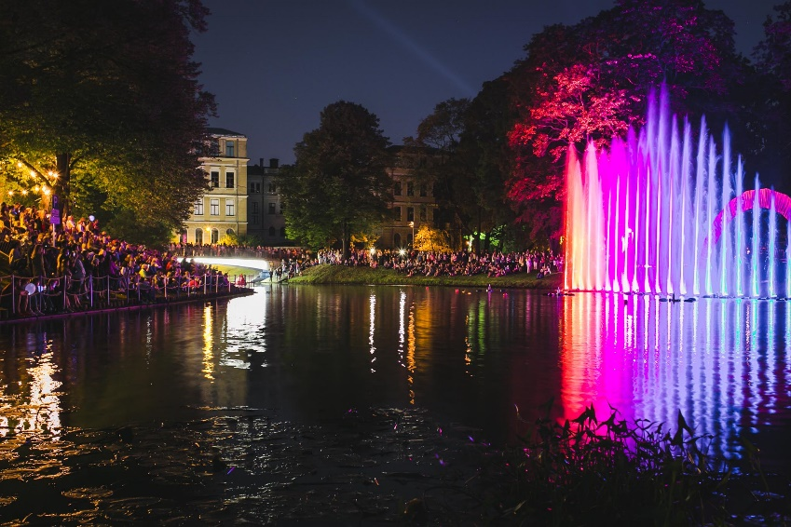
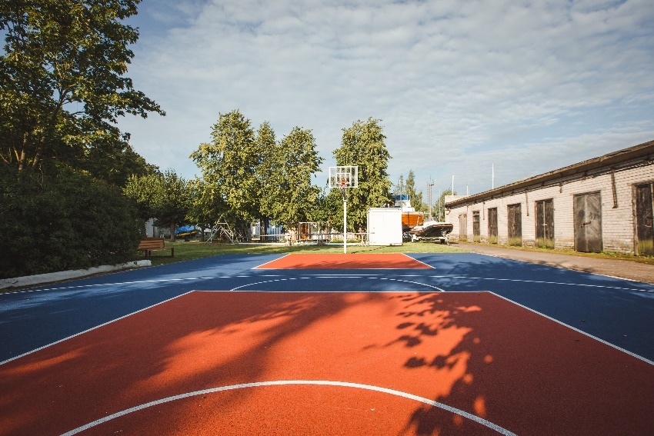
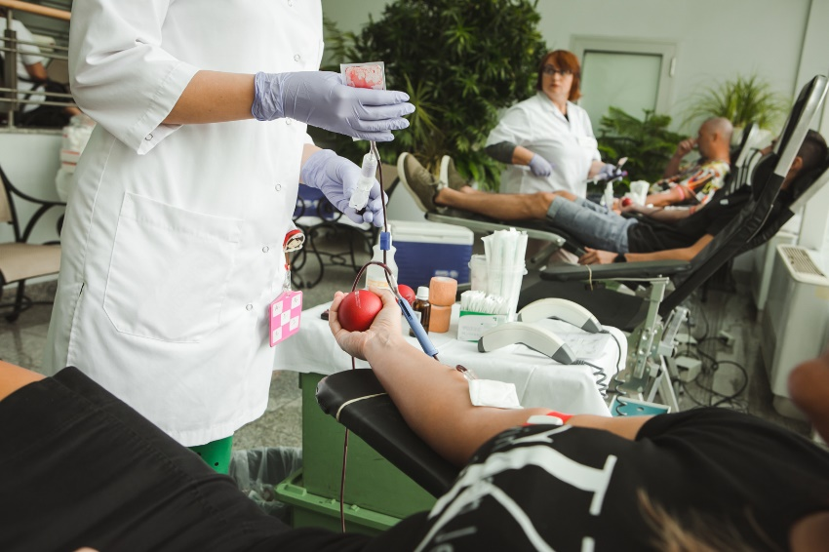
What have been the main difficulties to develop citizen activities in your port city?
Long after the restoration of Latvia's independence, it seemed to people that the port was something closed, completely isolated from the city, and thus unfriendly to the people. This view comes from the times of the USSR when access to the port and its territory indeed was restricted, and the town's inhabitants had no influence on this matter.
Citizens have lost the sense that the port is a place of work, a place for the exchange of goods and ideas, as well as a gateway to opportunities.
The presence of water (river) in the city is not sufficiently emphasized and used.
Key themes you would include in your future Port Center (if you plan one) or citizen activities
Quality of life of the port neighborhoods’ residents
Environmental Protection
Cooperation between the port and the city

Slide 5
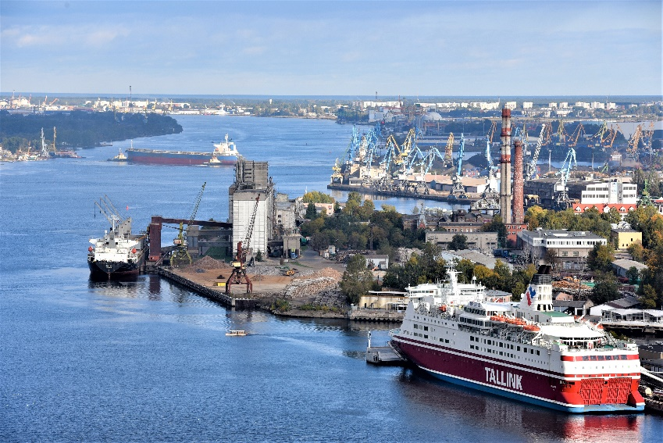
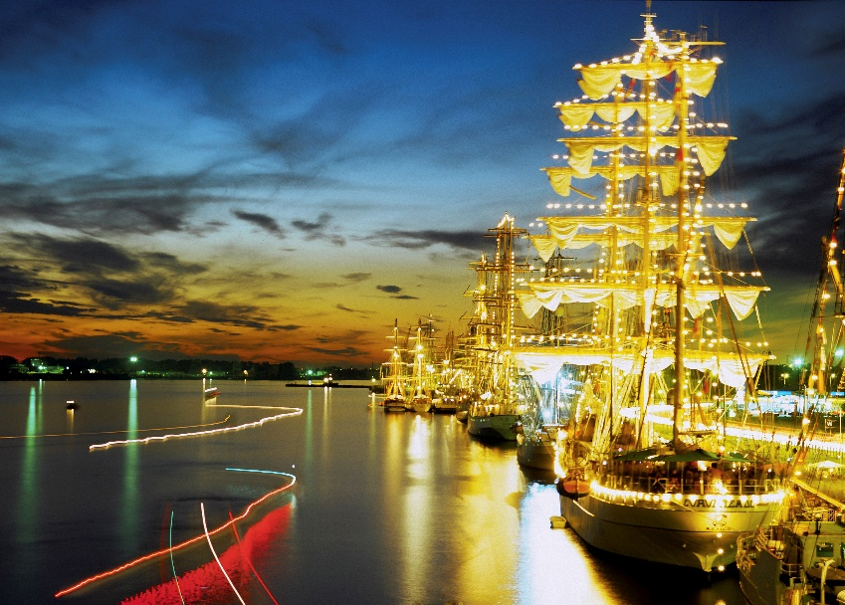
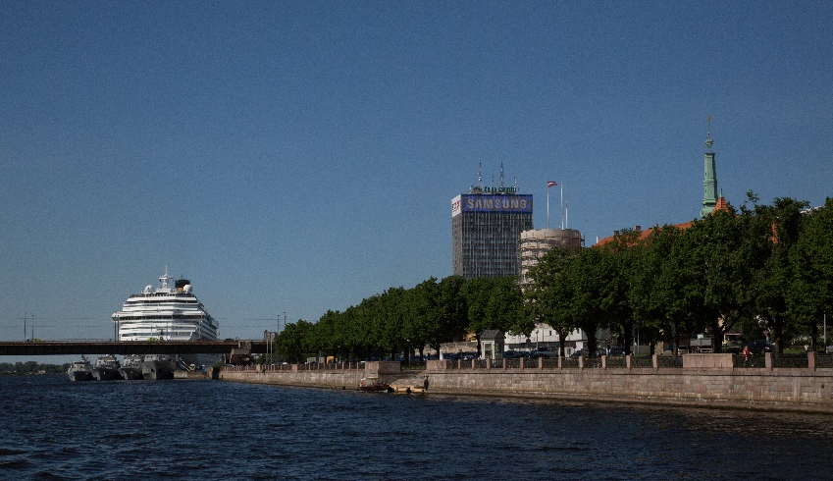
What are your goals/expectations for the PCN Meeting in Bilbao ?
To learn about Port Centers’ activities and best practices
To exchange information and learn best formulas of port-city cooperation
What useful knowledge should AIVP provide you with?
Advantages of Port Centers
Society’s view of the opening of Port Center and it’s participation for port city governance
Engaging of stakeholders in the Port Centers
Photo by:
Aleksandrs Kendenkovs
Key topics for future PCN Meetings
Financing possibilities and EU Funding
Replace for photo of your Port Center of Port City

