Slide 1
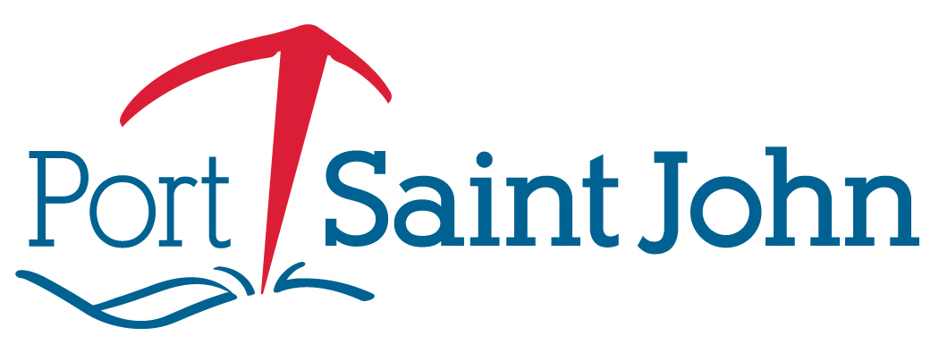
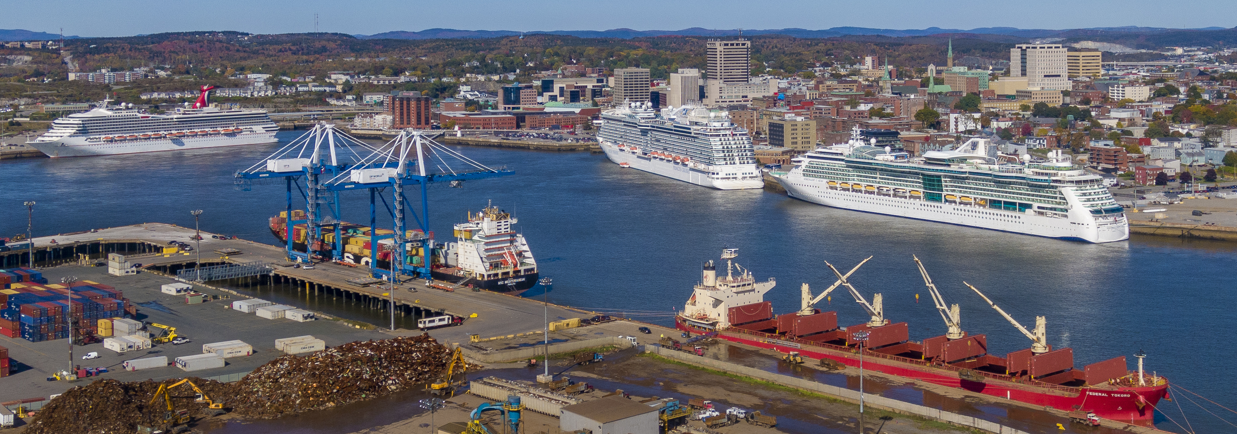
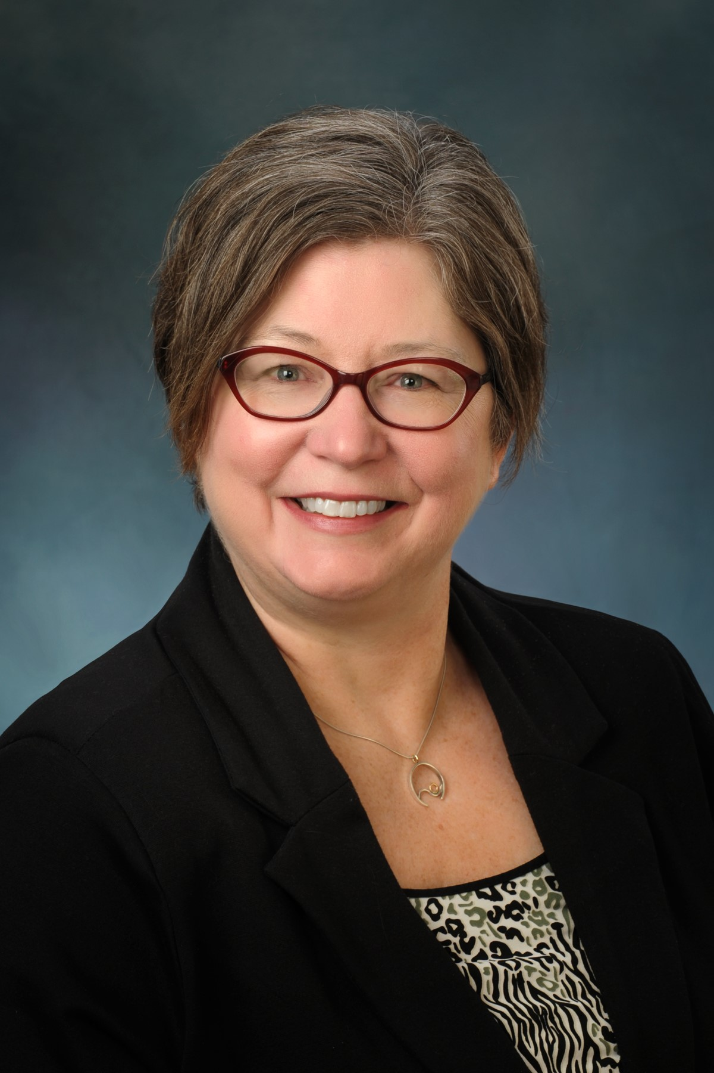
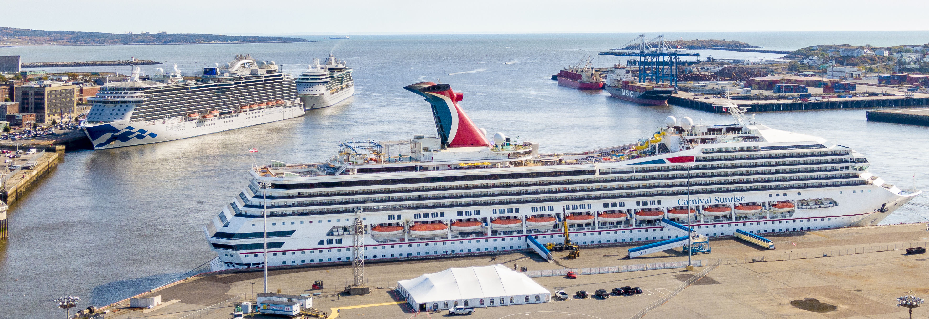
Port Saint John
Name: Paula Copeland
Position: Director Communications & Corporate Social Responsibility
Contact: pcopeland@sjport.com
Short description of your citizen program(s)

Slide 2
Key Data of citizen initiatives
Which actors do you usually collaborate with? Port Stakeholders, government and related agencies, Community leaders/members and Residents
Website with information about social activities (insert the link if you have): https://www.sjport.com/community/
Key Audience for your initiatives Children/families living in priority neighbourhoods surrounding the Port + general public
Social Initiatives recently developed | Year | Nº of visitors | Budget | Description
Community Day | 2011 – 2019 | 3500-5000 | $40,000 (including sponsorship) | This one-day, annual event brings our Port stakeholders and community together for an afternoon of fun and learning. This event has a significant sponsorship component and has broke even. Over the past 9 years the event has raised more than $100,000 CAD for charities working with children in need and prioritized on breaking the cycle of inter-generational poverty.
Inclusion Model (stakeholder and community engagement) | 2011 - now | 80-150 participants | $2,500 | The Inclusion Model was created and implemented in 2011 and has evolved into a primary tool by which the Port Saint John management team maintains a cycle of engagement with stakeholders in an inclusive manner. Semi-annual forums encourage presentations from both the Port Saint John team and from our stakeholders for the benefit of sharing priorities amongst members of the Port community. Working committees encourage project and issue specific engagement in intervals between the semi-annual forums. Feedback gathered from engagement through these activities is fed into the strategic planning process with the Board of Directors for the Business Plan annual update.
Port Education Program | 2014 – now | 800-1000/per year | $7,000 | Students from grades 3 through 10 are engaged with port learning opportunities through both in-class presentation materials and the opportunity to pair these with a weekly port tours. Our port tours are led by a trained educator and are carried out in co-operation with stakeholders at Barrack Point Potash Terminal, the container terminal and American Iron and Metal. Hundreds of students were provided up-close-and-personal experiences on these tours each year. In 2017, the program was further developed with the addition of a high school/careers module. This module was designed to highlight types of work in the port/marine transportation sector to with the goal of engaging students who may be making decisions about their future career path. In addition to these efforts, Port Saint John regularly partners with educational entities such as Enroute to Success, New Brunswick Community College, UNB Saint John and Saint John High School to provide intern and co-op opportunities for secondary and post secondary students.
Harbour Lights Campaign | 1998-now | Broadcast audience of CBC | $10,000 | Each year Port Saint John partners with CBC and Saint John Energy on the Harbour Lights Campaign to raise funds for 15 food banks from St. Stephen to Sussex. Over 22 years, the cumulative total amount raised from our generous communities in Southern New Brunswick surpasses $2.7 million.

Slide 3
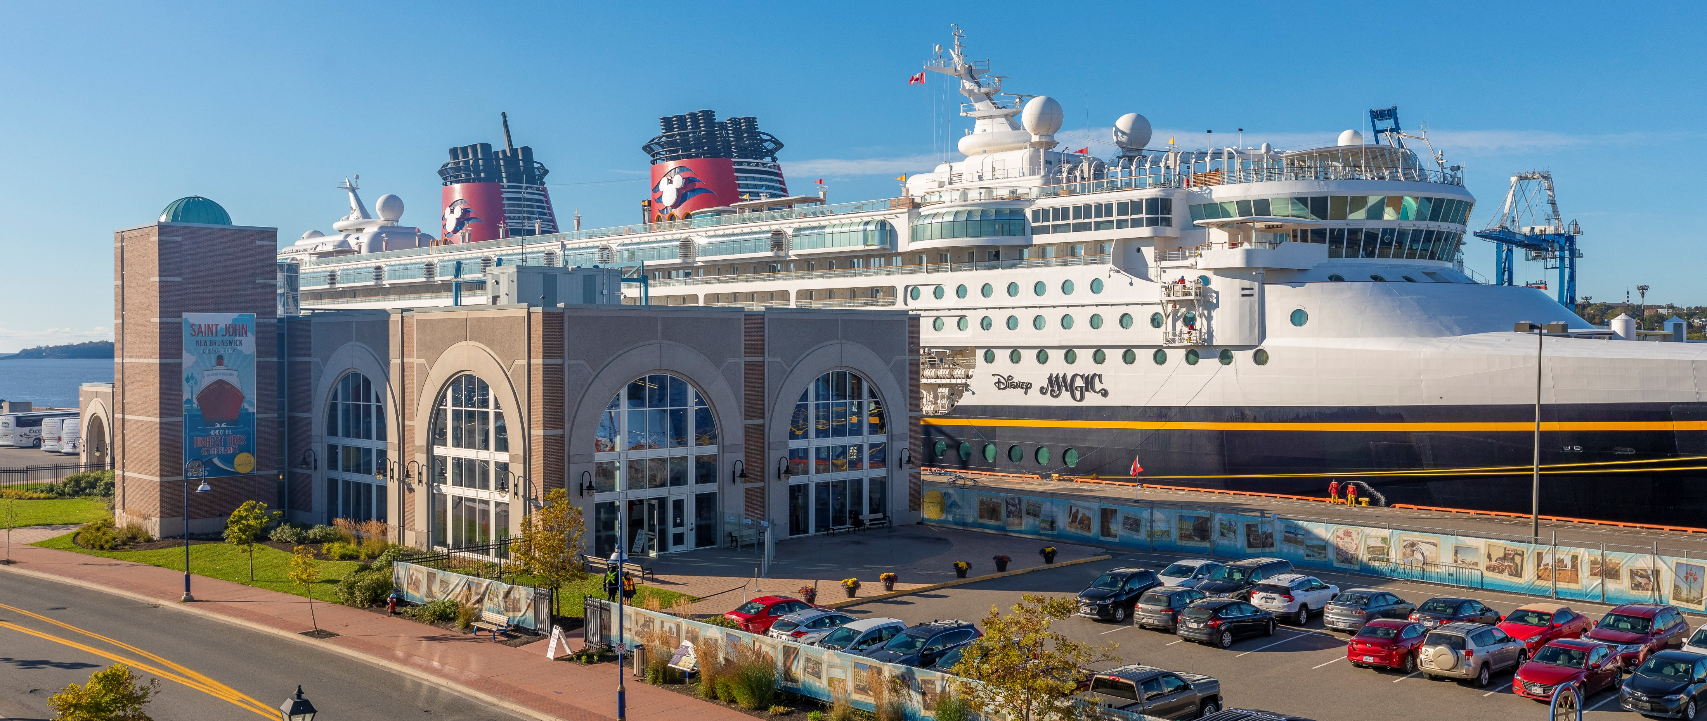
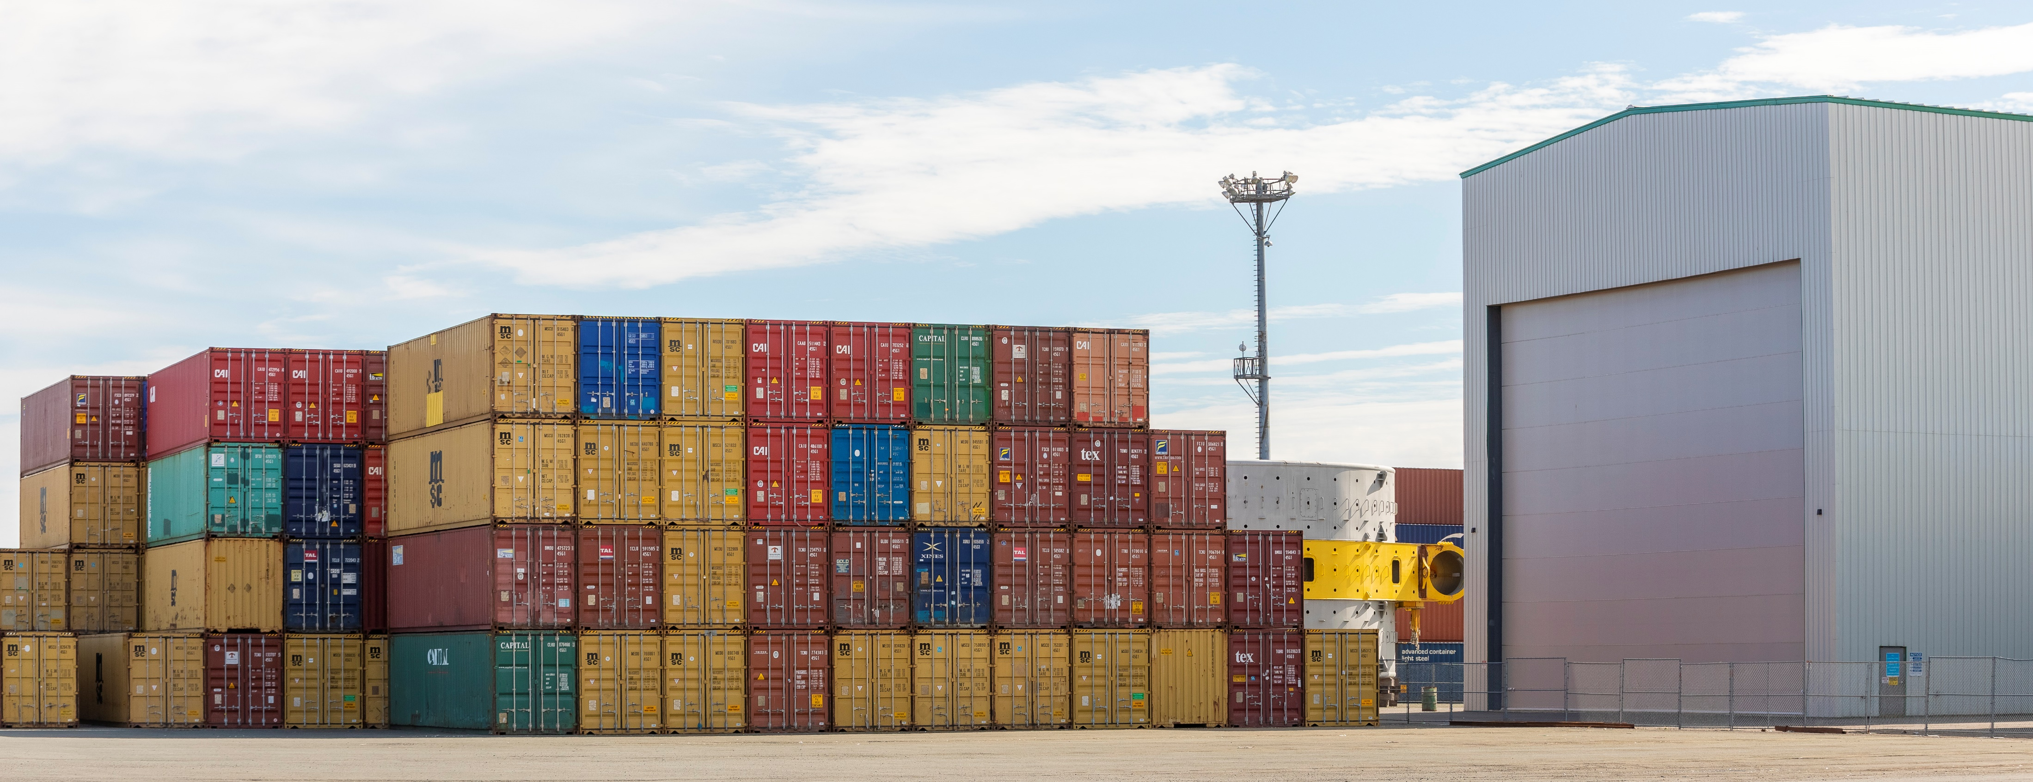
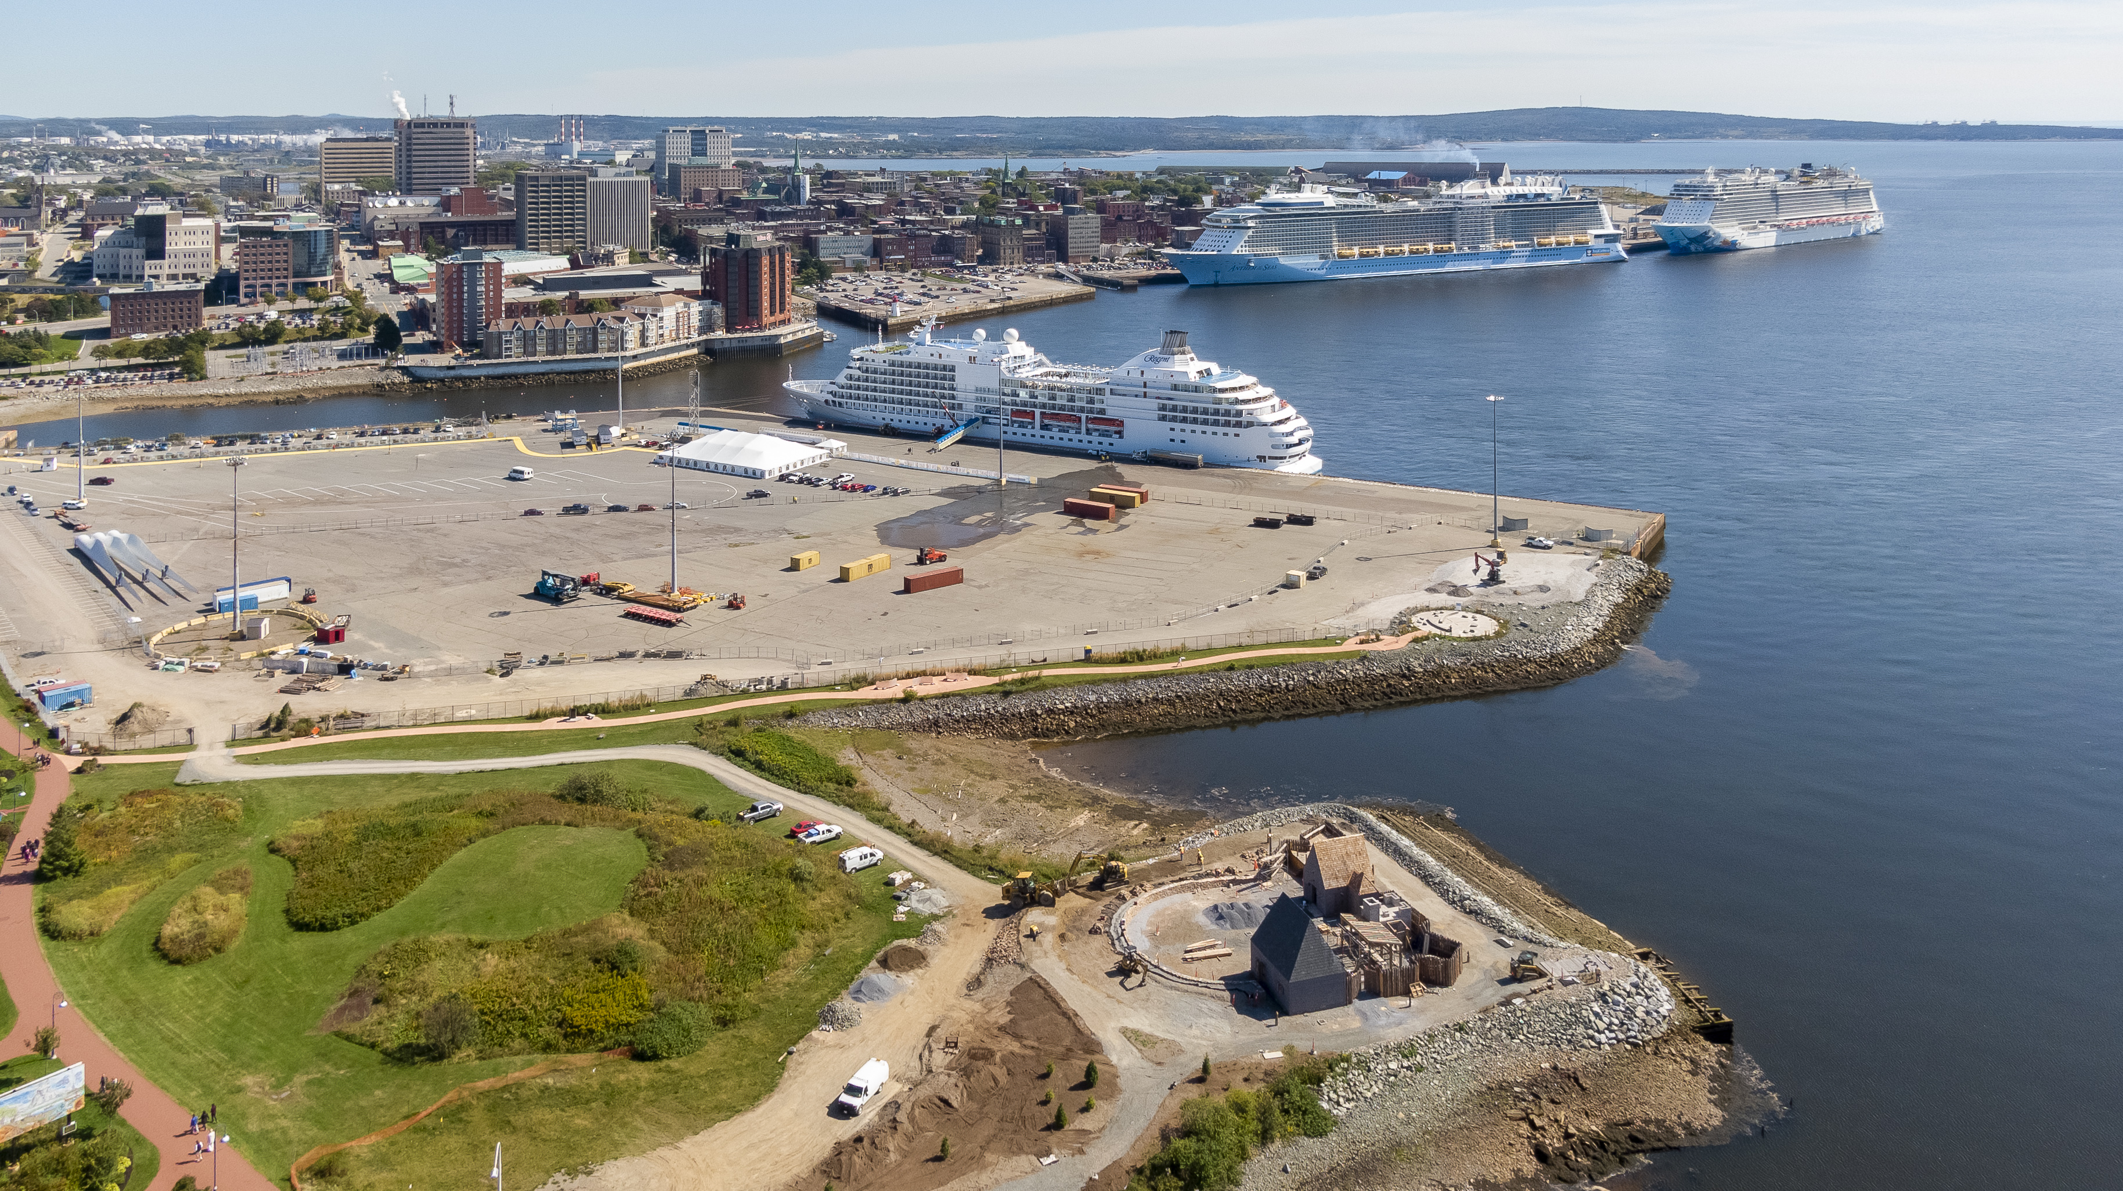
What have been the main difficulties to develop a citizen activities in your port city?
Example 1: Availabe human and financial resources from an operational perspective.
Example 2: Sustaining momentum in periods of friction.
Example 3: Incorporating a stronger presence from port stakeholders
Key themes you would include in your future Port Center (if you plan one) or citizen activities
Theme 1: Value of Port to Region
Theme 2: Importance of logistics chain and role of marine terminals in this
Theme 3: Focus on adaptation to climate change

Slide 4
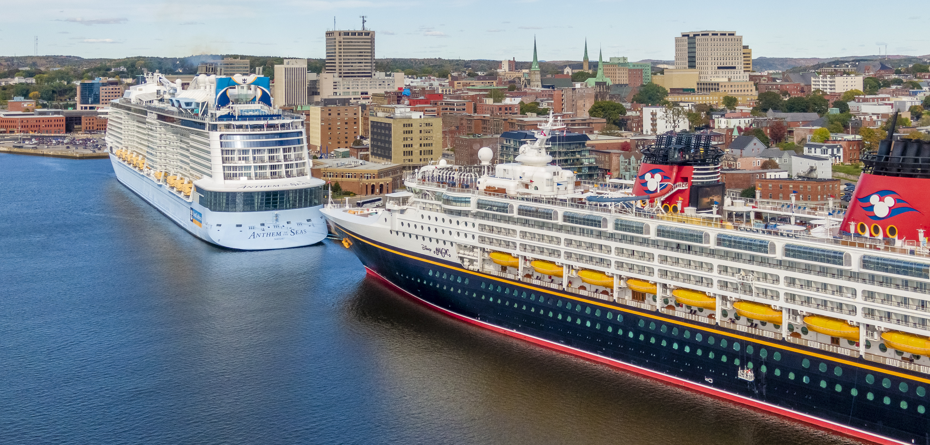
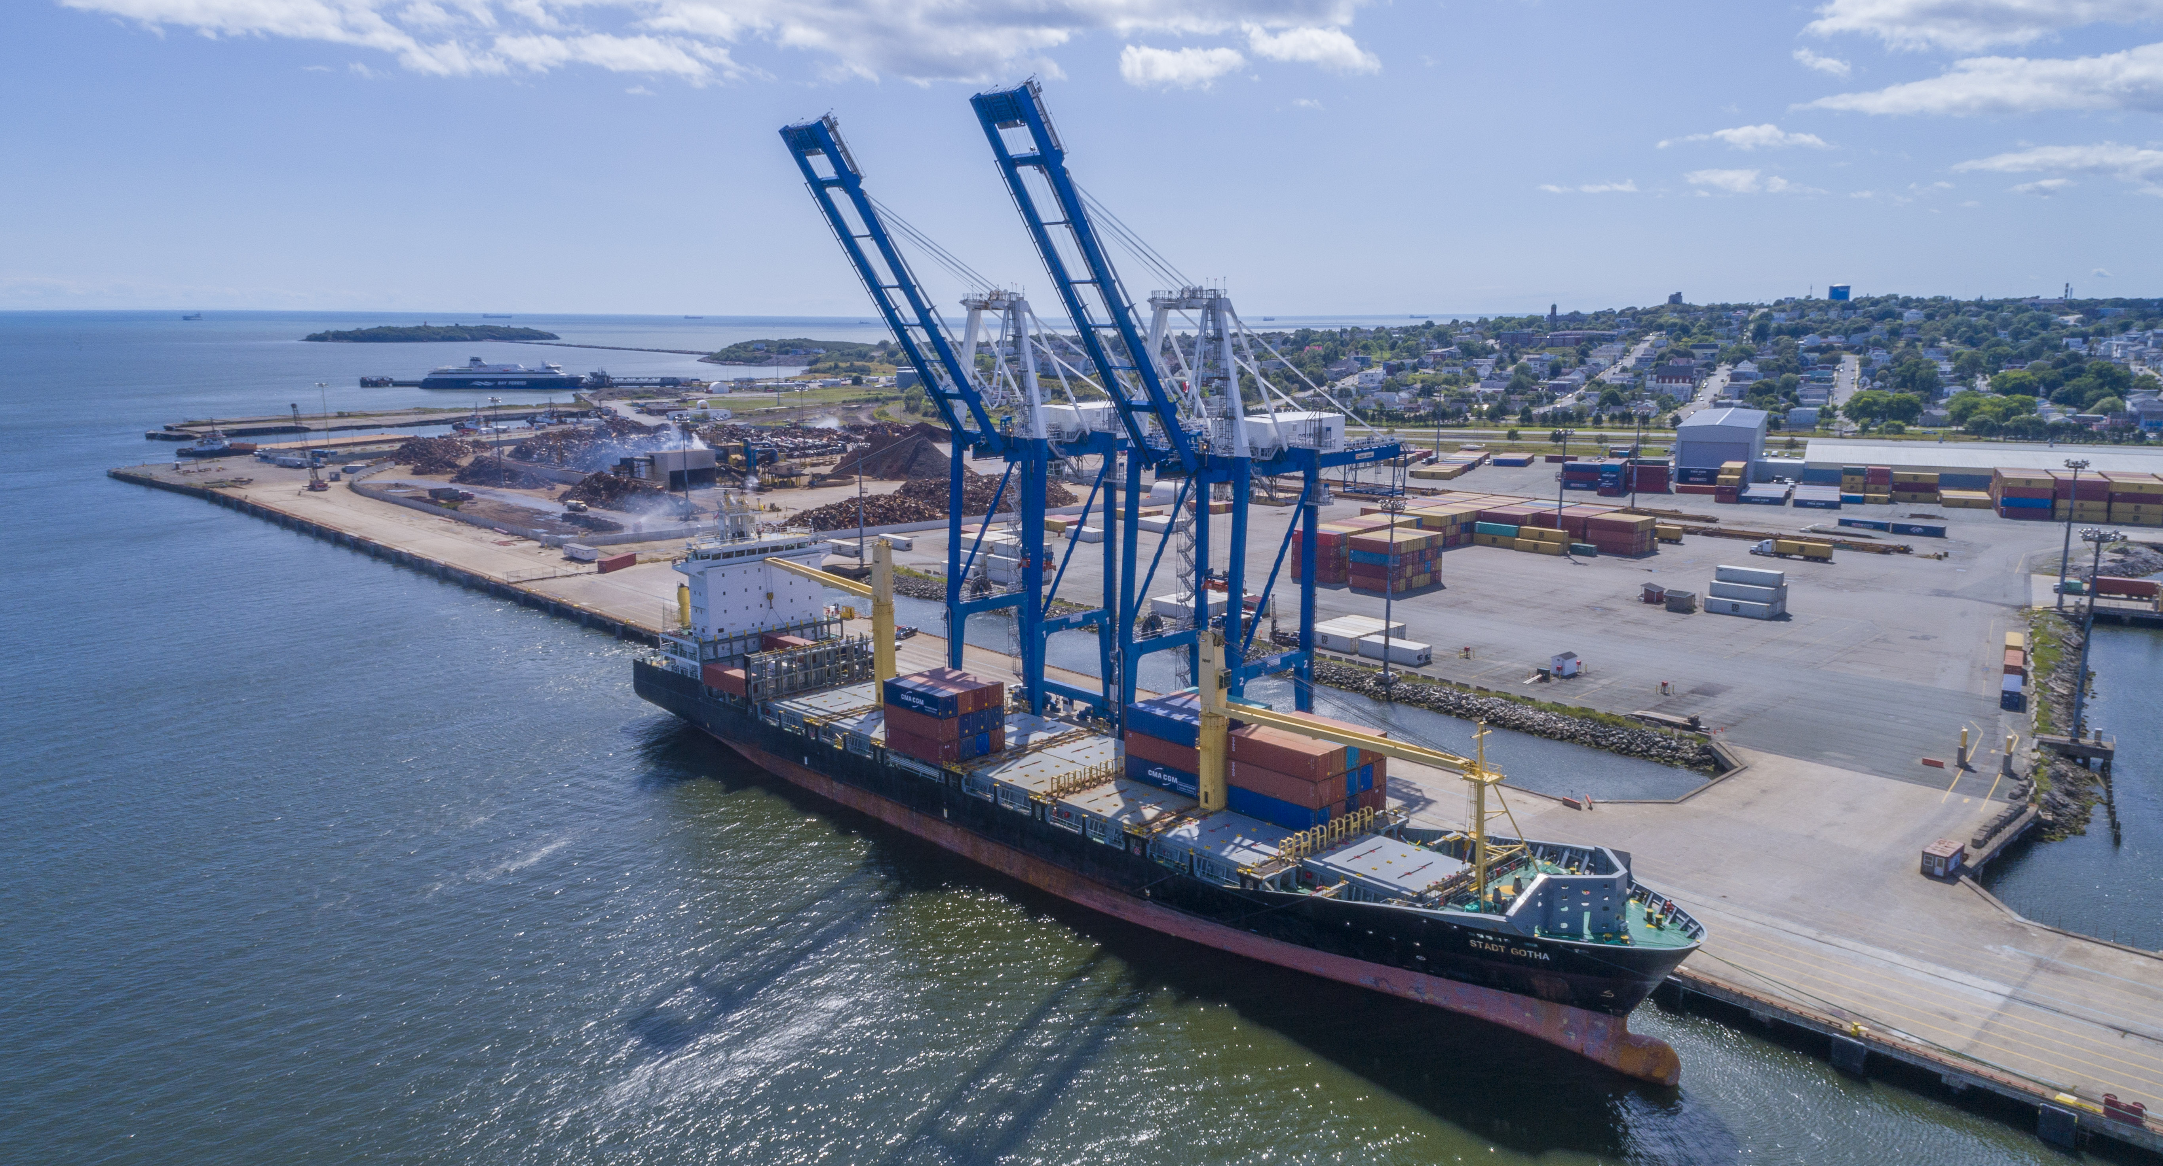
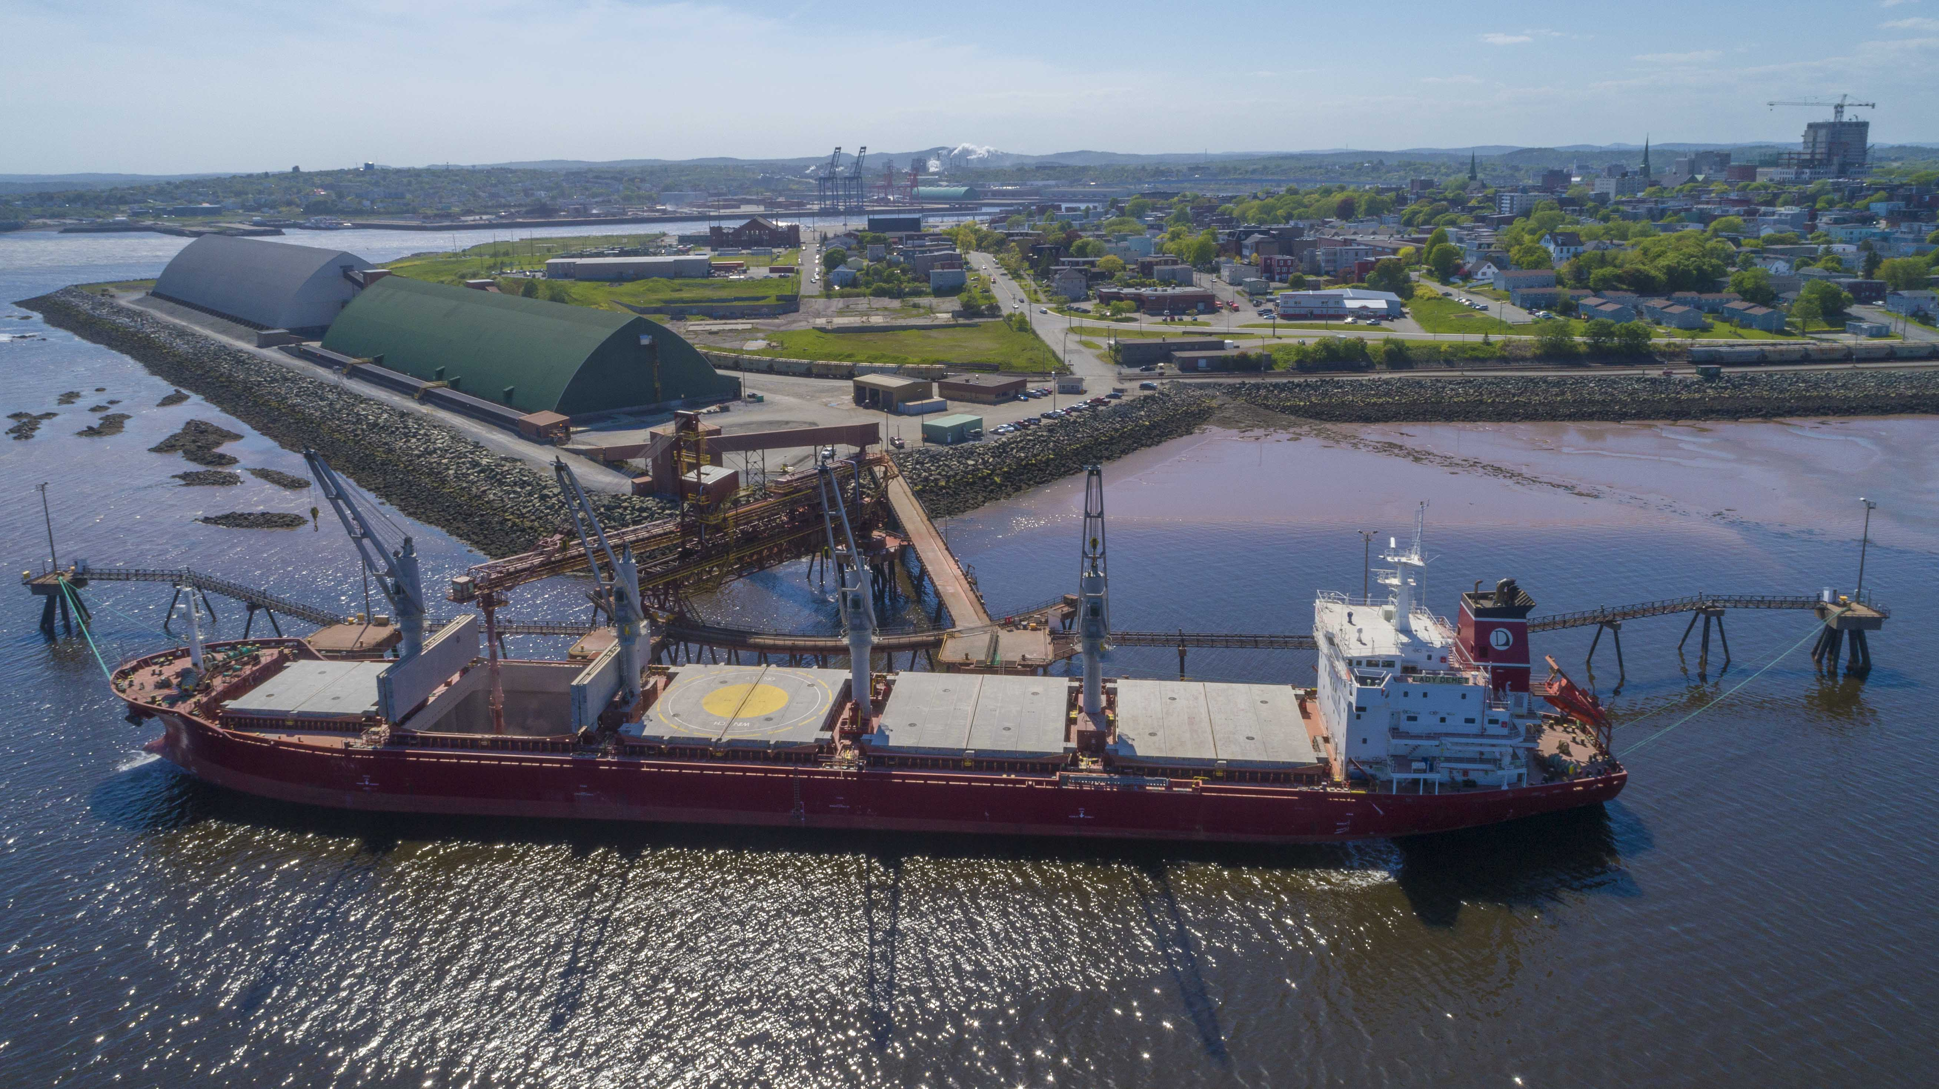
What are your goals/expectations for the PCN Meeting in Bilbao ?
1. To engage with colleagues who are facing similar issues
2. To learn from the Bilbao example
3. To evaluate value of a full AIVP membership for next year
What useful knowledge should AIVP provide you with?
How other ports are working with their municipalities, regions and publics
Key studies in mitigating the less desirable impacts of Ports for residents
Alignment with global industry trends in sustainability (eg Agenda 2030)
Key topics for future PCN Meetings
Best practices for working with local governments
Best practices for working with indigenous populations
Replace for photo of your Port Center of Port City

