Slide 1
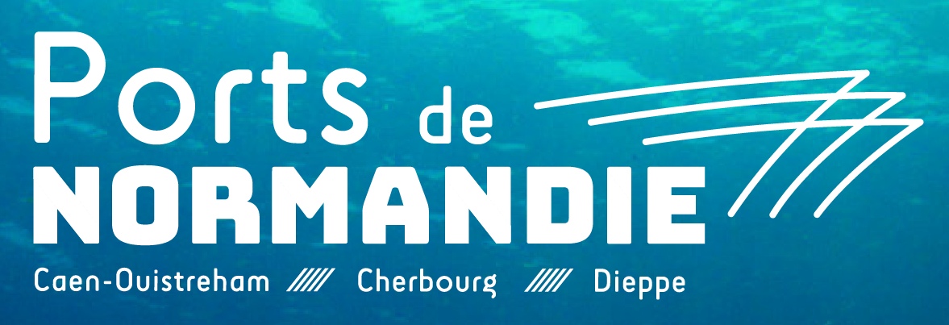
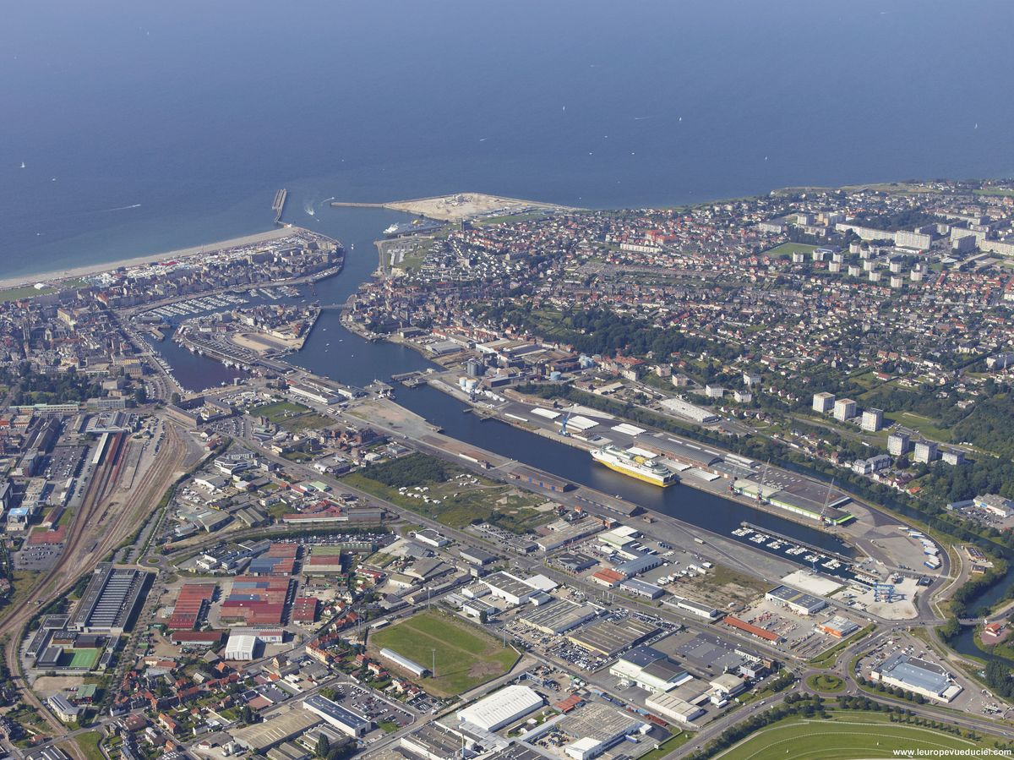
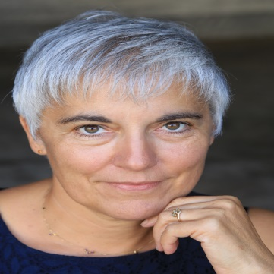
Syndicat Mixte Ports of Normandy –
Port of Dieppe
FOUCHAULT Marie-Dominique
Project manager to the director
Partenership with the ports of Seine-Maritime
marie-dominique.fouchault
@portsdenormandie.fr
Reception of the public for port visits, exchanges with professionals, exhibitions and cultural events, promotion of activities, various communication media
Port of Dieppe: cross-Channel activities, wind turbines, gravel and sea trade, fishing, boating, ship repair

Slide 2
Key Data of your citizen initiatives
Which actors do you usually collaborate with? : Normandy Region - Seine Maritime Department - Dieppe Maritime Agglomeration for actions to the trades and employment and promotion actions - Dieppe Maritime Tourist Office and City of Dieppe, City of Art and History for heritage tours- ESTRAN as maritime museum - Dieppe Navals and Logistics Seine Maritime as a cluster of companies on the port, The Association of the Channel Local Ports...
Website : http://www.portdedieppe.fr/
Key Audience for your initiatives : high school- students-companies-tourists-administrations- any local and regional audience
Social Initiatives you have recently developed | Year | Nº of visitors | Budget | Description
Port heritage visits - port activities and auction | Every year | from 10 to 30 people | NC | an agent of the port of Dieppe visits the Colbert Bridge, the dry port in the form of refit, auction and technical fishing area, spaces for cross-channel activity and trade
JL Saiz's photo exhibition on port activities and on dredging in the ports of the channel | 2013 | over several weeks | NC | Exhibitions on people practicing port work, on dredging in the ports of the Channel
yacht shows, ship repair, maritime services, logistics booth at regional events Armada, herring fair and scallop | Every year | NC | NC | port agents attend trade and tourism fairs
Dieppe Navals network of actors |  | fifty companies | NC | The port of Dieppe with the Dieppe Maritime agglomeration participates in the network of actors Dieppe Navals for the development of maritime activities

Slide 3
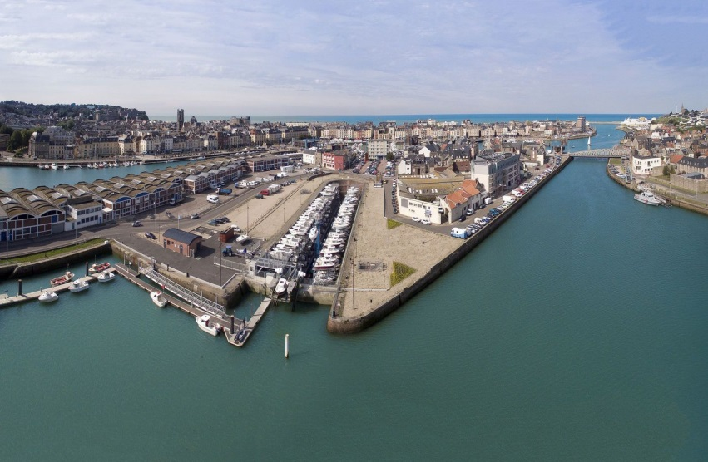
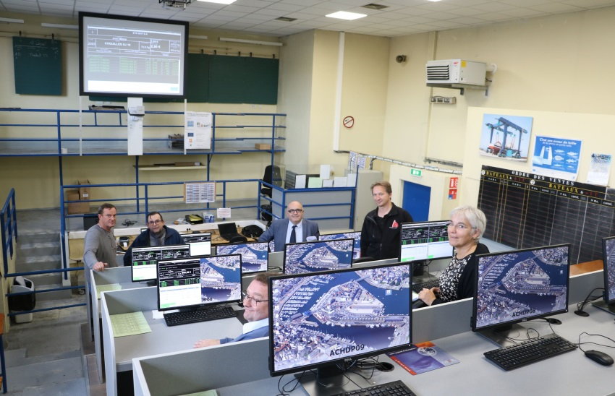
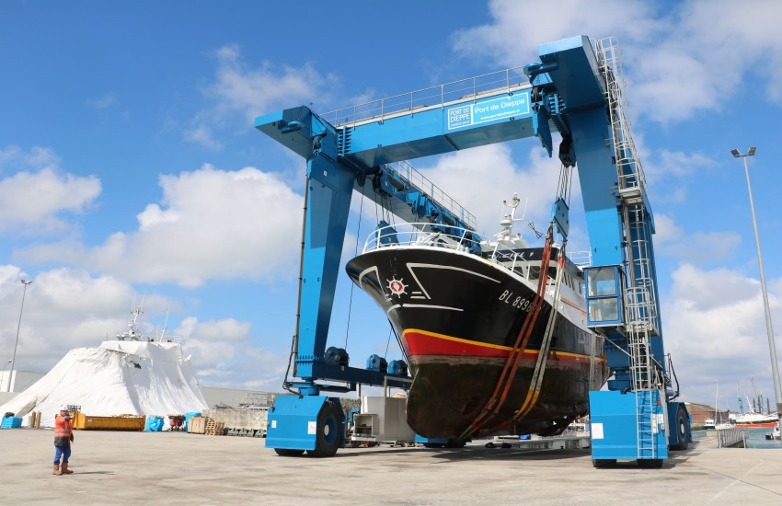
What have been the main difficulties to develop a citizen activities in your port city?
To respect the security and confidentiality of the activities while visiting port activities
To organize tourist visits while the activity is dépending on the tide
To have volunteer agents for the visit especially on weekends
Replace for photos of your Port City activities
Form of refit transformed into automated dry port
Key themes you would include in your future Port Center (if you plan one) or citizen activities
Theme 1 : cohabitation of port activities and that of a city; for example for fishing, for maritime trade activities, with risks
Theme 2 : the renovation of the maritime heritage and the necessities of circulating in the city and the port
Theme 3 : setting up a port network in a maritime territory
landed fishing, auction and fish market
technical area and ship repair

Slide 4
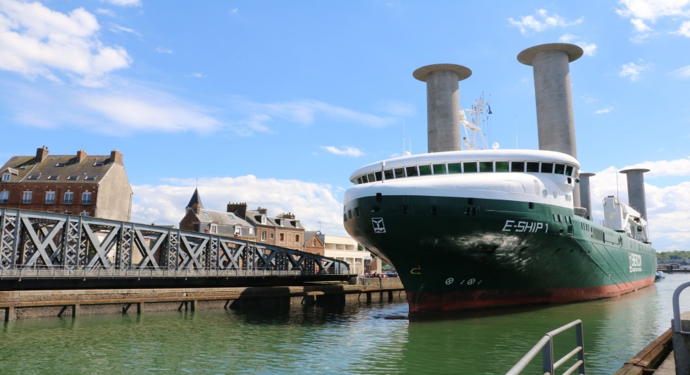
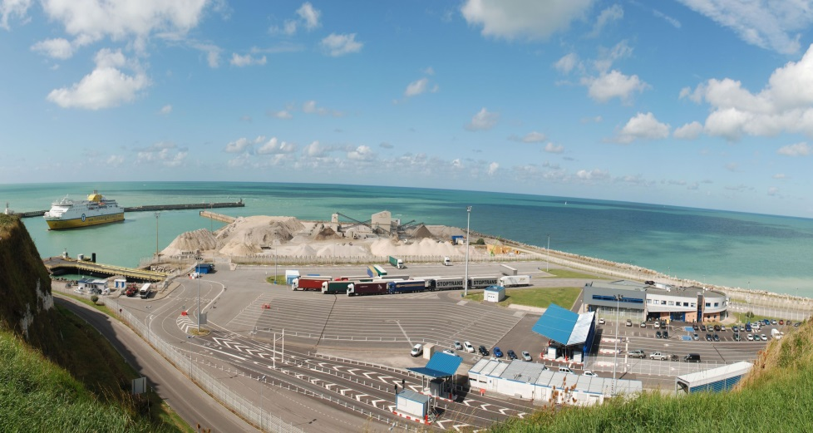
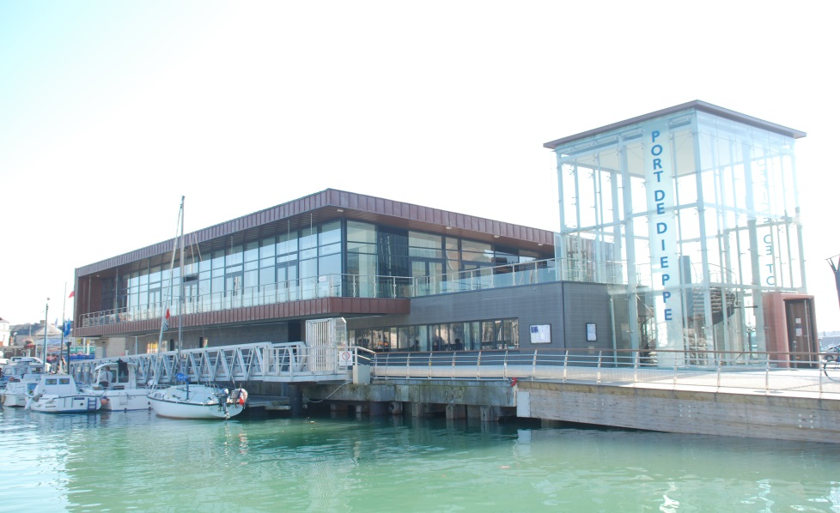
What are your goals/expectations for the PCN Meeting in Bilbao ?
1-meet people who set up public information programs on port activities
2- exchange port experiences in France and abroad
Aeolian maritime trade and Colbert bridge listed as a historic monument
What useful knowledge should AIVP provide you with?
1- contacts, knowledge of ports…
2- rotate exhibitions
Dieppe Newhaven Cross Channel Waterway
Key topics for future PCN Meetings
1- setting up Port center adapted to each port while promoting a port network in a maritime area for effective communication with citizens
Ango building for boaters and Tourist Office

